Slide 1
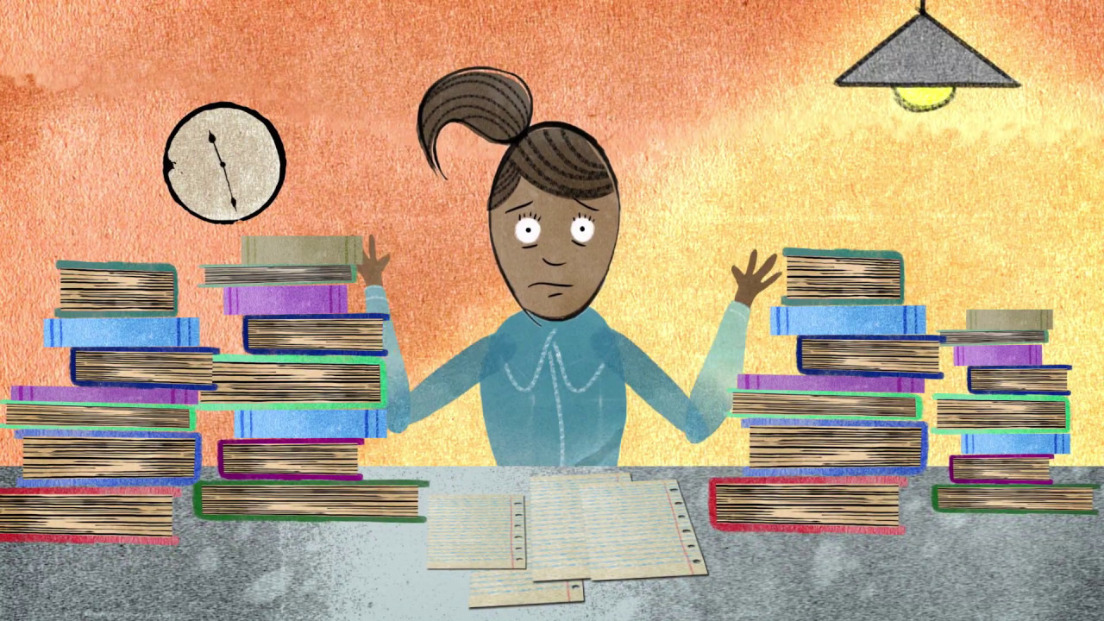
Dealing with academic and exam anxiety
Professor Oumama Kabli
November 14, 2018

Slide 2
Academic Anxiety and the Fear of Failure
Academic anxiety is almost always due to negative thoughts, especially about the possibility of failure or poor performance.
What are some ways we can overcome negative thoughts in school?

Slide 3
The TUF Approach
T, U, F → TRY, USE, FUN

Slide 4
TRY
Instead of putting off things and avoiding threatening but harmless situations, get into the habit of trying particular skills every day.
For example: If you have had a fear of speaking in class, then practice the skill but in smaller bites. When you arrive in the classroom, make a point of greeting the classmates on either side of you. Or, trying to participate in class.

Slide 5
USE
The use part of the formula means literally using the skills frequently to increase your strength in your behavior repertoire. It is well established that skills which are frequently used will strengthen. Those which are ignored and allowed to become idle are likely to weaken and possibly disappear. For example: By using participation skills most days, you can move from fear to confidence and from your hesitation of public speaking

Slide 6
FUN
FUN is something we all like.
When trying to increase your classroom speaking skills, look for amusing stories and anecdotes which relate to topics being discussed in class.
Practice telling anecdotes to two or three friends or perhaps several family members. Enjoy the humorous situation and be prepared to laugh, especially at yourself. The principle is to start out in a small way and progress gradually to larger groups.

Slide 7
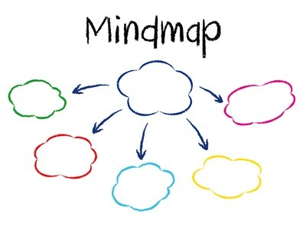
Activity #1
Create a mind-map in a group using the word “Exam.”

Slide 8
Learning How to Relax
Whether you are an anxious person or not, relaxation training can produce a very positive result.
1. Be sure to practice twice daily, especially on busy days — that's when you will need the relaxation and benefit most from its effects.
2. Develop the expectation that you will relax, but don't try too hard.
3. Find a quiet setting where you will not be disturbed.
4. Make yourself as comfortable as possible. It's best not to lie down in bed as you are likely to drift off into sleep.
5. Focus upon your breathing. Just breathe comfortably and notice how pleasant it feels to listen to the air flowing in and out.

Slide 9
Learning How to Relax cont…
6. Over the next ten breaths, count to yourself successively from one to ten as you breathe in and say `Relax' to yourself as you breathe out. If your mind is still quite active and strays from the procedure, then trace the numbers in your palm to fix your mind more strongly onto the relaxation process.
7. Concentrate upon the body muscles and move from head down to feet, relaxing the muscles of your body. Simply focus your attention on the following muscle groups and then say, `Relax'. Feel the tension flowing out and systematically relaxing your body. Start by relaxing your forehead and then move downwards: eyebrows, eyelids, cheeks, mouth, jaws, neck, shoulders, back, upper and then lower arms, chest, abdomen, thighs, calves, ankles and feet.

Slide 10
Learning How to Relax cont…
8. To deepen the relaxation effect, imagine now that you are descending a staircase to a warm and quiet beach. As you see yourself stepping slowly downwards from step to step, associate the familiar feeling of stepping down one step with a stronger feeling of relaxation. When you reach the bottom of the staircase, see yourself walking out onto the beach and then stretching out on a beach towel.
9. When fully relaxed, say to yourself: `I can relax my mind and body. I am in control.’
10. After you have enjoyed the feeling of relaxation for a few minutes, then slowly count from one to five, open your eyes and come back to your previous state of functioning. Stay in the same position and then slowly stretch your arms and legs.
11. You can experience a mini-relaxation effect by briefly paus- ing any time during your days and taking a comfortably deep breath and then slowly letting the air out while you say `R-e-l-a-x-x-x' to yourself.

