Slide 1
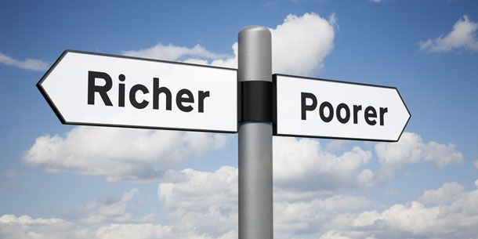
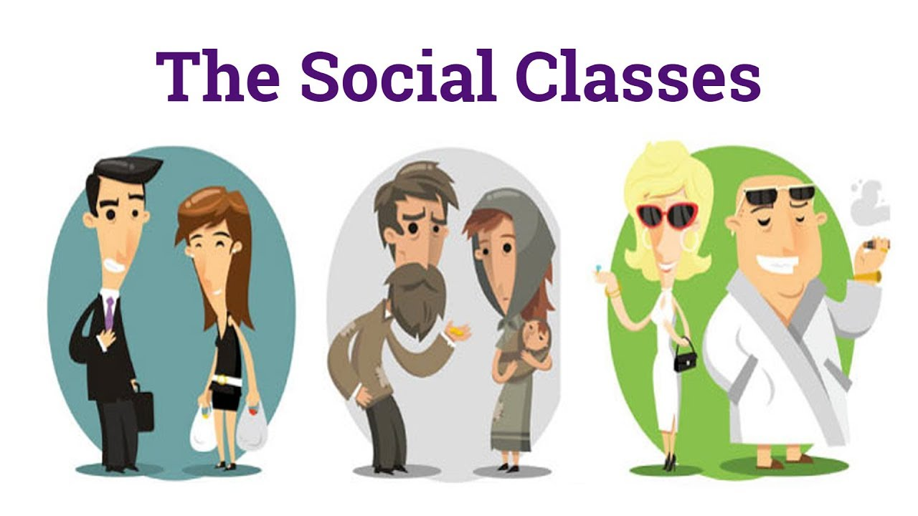
Classes in American Society, “The American Dream,” & Immigration
Professor Oumama Kabli
November 12, 2018

Slide 2
Social Classes in the United States
What is socioeconomic status? Socioeconomic status is the social standing or class of an individual or group. It is often measured as a combination of education, income and occupation.
The United States has roughly six social classes: upper class, new money, middle class, working class, working poor, poverty level

Slide 3
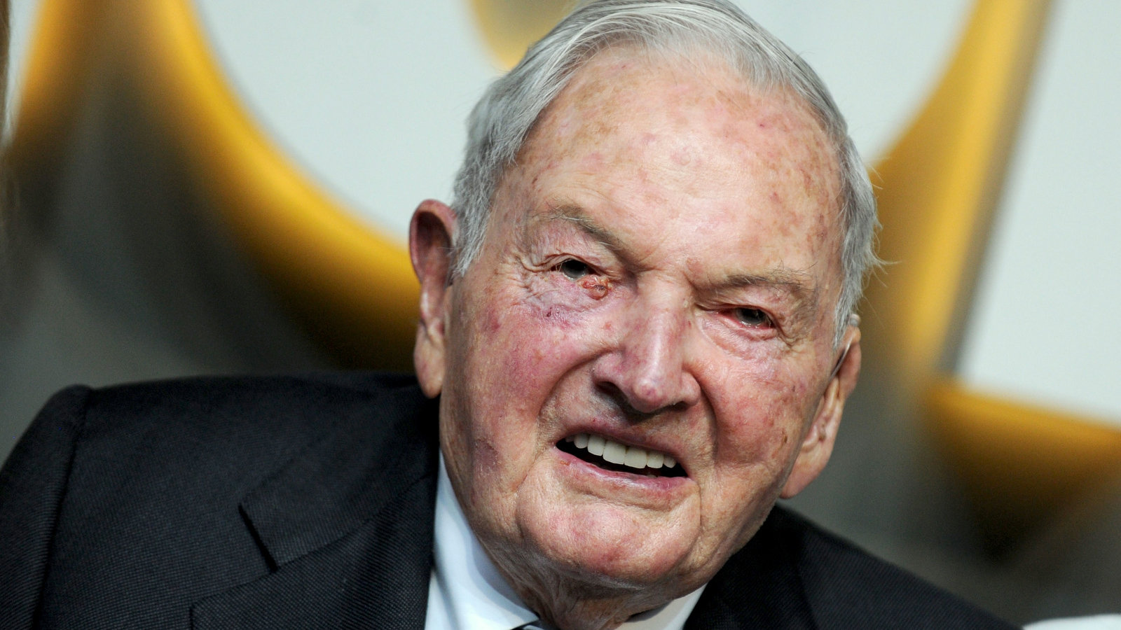
Upper class
The Upper Class, makes up about one percent of the U.S. population.
It generally consists of those with vast inherited wealth (sometimes called “old money”).
Members of the upper class may also have a recognizable family name, such as Rockefeller, or Kennedy.
Some members of the upper class work, but their salaries are not their primary sources of income. Most members of this class have attended college, most likely at some of the most prestigious educational institutions in the country.
Example: The Kennedy family is a prime example of an upper-class family. Joseph P. Kennedy made his fortune during the 1920s and passed it down to succeeding generations.

Slide 4
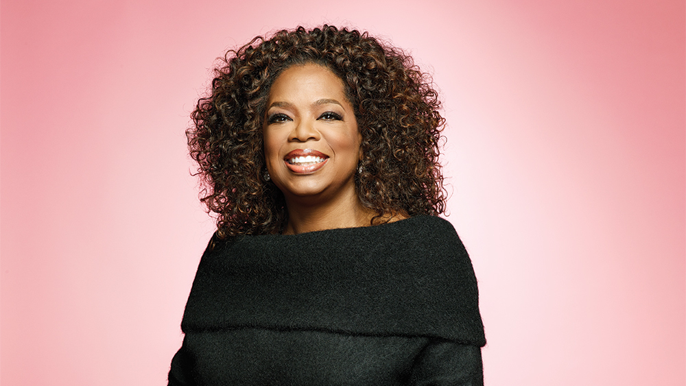
New Money
New Money is a relatively new in the social ladder and makes up about 15 percent of the population.
New money includes people whose wealth has been around only for a generation or two. Also referred to as the nouveaux riches(French for “newly rich”), they have earned their money rather than inheriting it. Unlike the members of the upper class, they do not have a family associated with old money.
Example: Oprah Winfrey, Michael Jordan, Bill Gates, and other celebrities, athletes, and business people fit into this category.

Slide 5
Middle class
the Middle Class, includes about 34 percent of the population.
The members of the middle class earn their money by working at what could be called professional jobs. They probably have college educations, or at least have attended college. These people are managers, doctors, lawyers, professors, and teachers. They rarely wear uniforms, although some might wear distinctive clothing, such as a physician’s white coat.
They are often referred to as the White-Collar class, referring to the tendency of many middle-class men to wear suits with a white shirt to work.

Slide 6
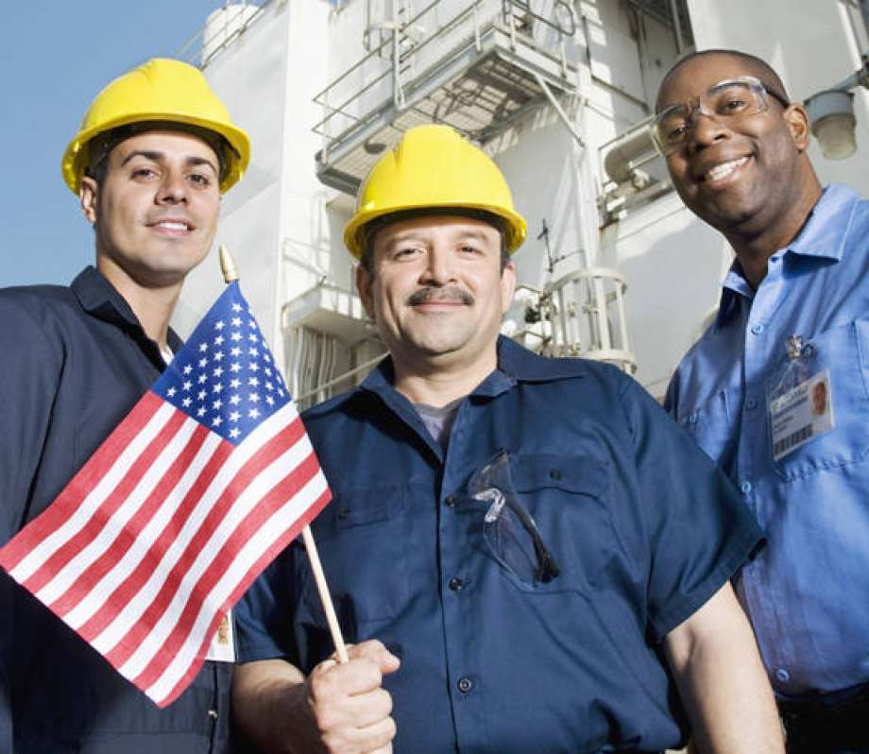
The Working Class
The Working Class makes up about 30 percent of the population. Its members may have gone to college, but more have had vocational or technical training. The members of the working class have a variety of jobs, including the following:
Electrician
Carpenter
Factory worker
Truck driver
Police officer
This category is also called the Blue-Collar class in recognition of the likelihood that many of these individuals wear uniforms to work rather than suits.
People in the working class are more likely to be members of unions than are people in the middle class. While there are differences between the working class and the middle class in terms of their values, behaviors, and even their voting records, their standards of living are often similar, but not identical.

Slide 7
The Working Poor
Estimating how many Americans are in this category is difficult because the line separating them from those who are at or below the poverty level is not solid.
Estimates say that approximately 20 percent of the population could be classified in either the working-poor or poverty-level categories.
People in the working-poor category have a low educational level, are not highly skilled, and work at minimum-wage jobs. They often work two or more part-time jobs and receive no health insurance or other benefits. These individuals are vulnerable to falling below the poverty line. They have very little or no job security, and their jobs are easily outsourced to countries where labor is cheaper.
Every economy needs a group of workers that it can hire during an economic upswing and lay off when the economy weakens. The members of the working poor are such people; they are the “last hired, first fired.”

Slide 8
Poverty Level - Poverty In America
A staggering number of Americans currently live below the poverty level.
About 66 percent of poor people are white, reflecting the fact that white people outnumber people of other races and ethnic groups in the United States. About 25 percent of the people living in poverty are black.
Though all states have poverty, poor people are concentrated in the inner cities and in the rural South
→ high level of poverty in inner cities is due to the lack of jobs. many companies have relocated to suburban areas or have downsized their urban operations
→ Educational levels in the South tend to be lower. About 12 percent of the general U.S. population drops out of high school; in the South the dropout rate is about 15 percent. The increasing demands of technology require employees who are flexible, skilled, and able to learn rapidly. A workforce composed of people with relatively low levels of education and few job skills is simply not attractive to potential employers.

Slide 9
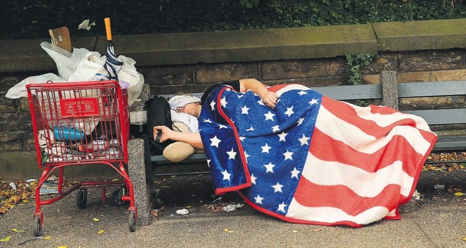
The consequences of poverty
the poor suffer from short life expectancies and health problems, including heart disease, high blood pressure, and mental illness. Reasons include the following:
Poor people are often not well educated about diet and exercise. They are more likely than people in higher social strata to be overweight and suffer from nutritional deficits.
They are less likely to have health insurance, so they put off going to the doctor until a problem seems like a matter of life and death. At that time they must find a public health facility that accepts patients with little or no insurance.
Living in poverty brings chronic stress. Poor people live every day with the uncertainty of whether they can afford to eat, pay the electric bill, or make the rent payment. Members of the middle class also have stress but have more options for addressing it.

Slide 10
Culture of Poverty
First coined by Anthropologist Oscar Lewis
Culture of Poverty means that poor people do not learn the norms and values that can help them improve their circumstances; hence, they become trapped in a repeated pattern of poverty.
Because many poor people live in a narrow world in which all they see is poverty and desperation, they never acquire the skills or the ambition that could help them rise above the poverty level. Since culture is passed down from one generation to the next, parents teach their children to accept their circumstances rather than to work to change them. The cycle of poverty then becomes self-perpetuating.

Slide 11
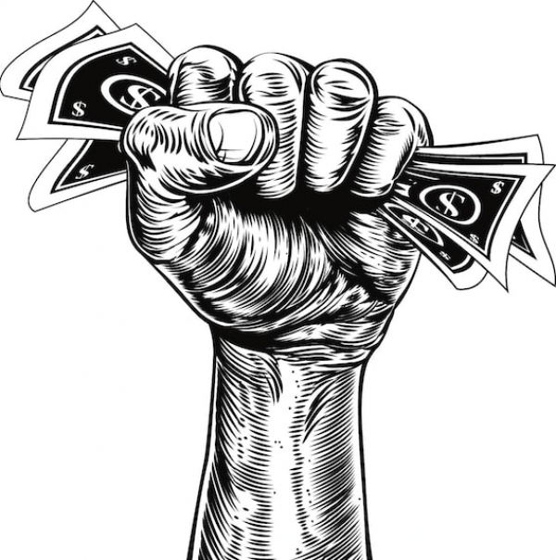
Minimum wage in the United States
A minimum wage is the lowest wage per hour that a worker may be paid, as mandated by federal law.
Even though the United States enforces a federal minimum wage, individual states, cities, and localities may also pass different minimum wage requirements as long as the stipulated hourly wage is not lower than the federal minimum wage.

Slide 15
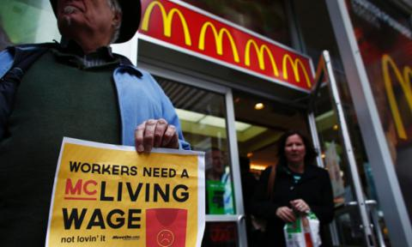
McDonald’s and the fight for $15
In 2015, McDonald's employees were among hundreds of fast food workers who were protesting for a national minimum wage of $15 an hour.
McDonald's said it would pay all workers at corporate-owned stores in the U.S. at least $1 an hour above the local minimum wage. → fast forward to today and that still has not happened at all locations
Burger chains like McDonald’s are facing record-high turnover as workers depart for better jobs options in a tightening labor market.
What do you think? Should fast food workers at McDonald's be paid $15 an hour?

Slide 16
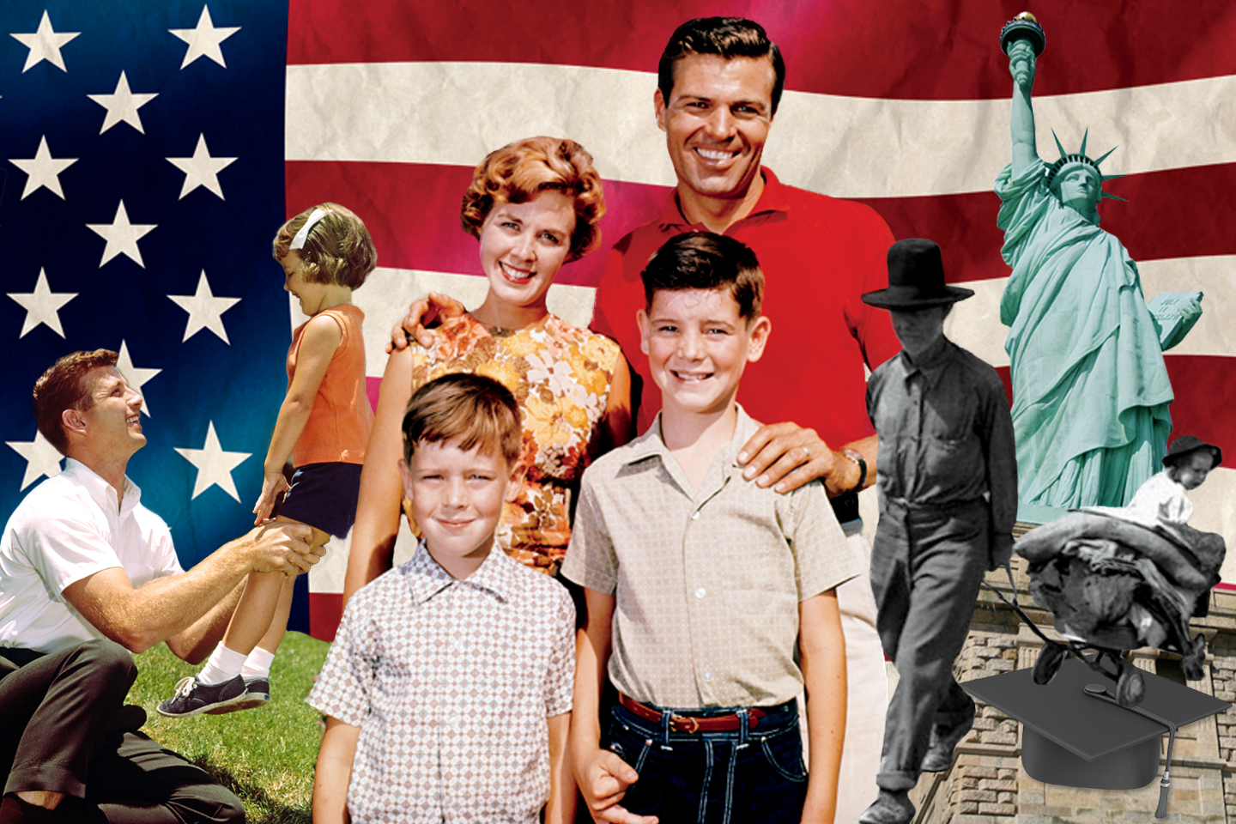
The “American Dream”
The “American Dream” is the belief that anyone, regardless of where they were born or what class they were born into, can attain their own version of success in a society where upward mobility is possible for everyone. The American Dream is achieved through sacrifice, risk-taking and hard work, not by chance.

Slide 17
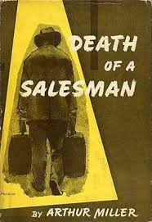
“Death of a salesman”
”Death of a Salesman” was a play written by Arthur Miller in 1949.
To the protagonist of "Death of a Salesman," the American Dream is the ability to become prosperous by mere charisma.
Willy Loman believes that personality, not hard work and innovation, is the key to success. Time and again, he wants to make sure his sons are well-liked and popular.
The central conflict in "Death of a Salesman," is Willy Loman’s inability to accept that being well-liked is not the only thing that gets someone through life. He is so set in his ways of thinking that it affects not only his life but everyone around him as well, especially his children.

Slide 18
The “American Dream” Cont…
The term was first coined by writer and historian James Truslow Adams in his best-selling 1931 book "Epic of America." He described it as "that dream of a land in which life should be better and richer and fuller for everyone, with opportunity for each according to ability or achievement."
he American Dream also offers the promise that the circumstances of someone's birth – including whether they were born as American citizens or immigrants – do not completely determine their future.
The American Dream was aided by a number of factors that gave the United States a competitive advantage over other countries. For example: it is relatively isolated geographically, compared to many other countries, and enjoys a temperate climate. It has a culturally diverse population that businesses use to foster innovation in a global landscape. Its abundant natural resources – including oil, arable land and long coastlines – generate food and income for the country and its residents.

Slide 19
Does the “American Dream” exist?
What in popular culture exemplifies the American Dream?
Are big houses and money goals to value?
How do we create equal access to the American Dream?

Slide 20
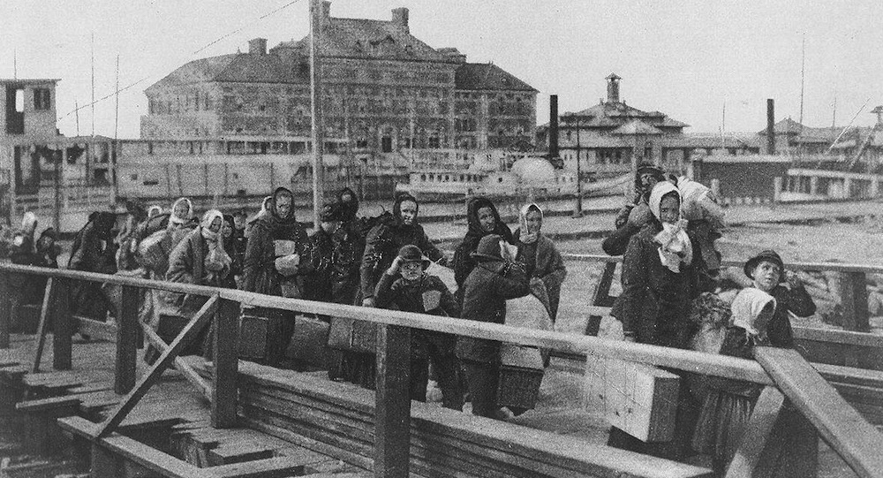
Immigration in the United states – Ellis Island
Ellis Island was the largest immigration station in the United States from 1892 to 1924.
Over 12 million immigrants came through Ellis Island during this period. The island was nicknamed the "Island of Hope" for many immigrants coming to America to find a better life.

Slide 21
Ellis island cont…
Ellis Island operated from 1892 to 1954. The federal government wanted to take control of immigration so it could make sure that immigrants didn't have diseases and were able to support themselves once they arrived in the country.
Over 12 million people were processed through Ellis Island between 1892 and 1924. After 1924, the inspections were done before people got on the boat and inspectors on Ellis Island just checked their papers. Around another 2.3 million people came through the Island between 1924 and 1954.

Slide 22
Immigrations trends today
More than 43.7 million immigrants resided in the United States in 2016, accounting for 13.5 percent of the total U.S. population of 323.1 million, according to American Community Survey (ACS) data.
Between 2015 and 2016, the foreign-born population increased by about 449,000, or 1 percent, a rate slower than the 2.1 percent growth experienced between 2014 and 2015.
Immigrants and their U.S.-born children now number approximately 86.4 million people, or 27 percent of the overall U.S. population, according to the 2017 Current Population Survey (CPS).

Slide 23
Immigrations trends cont…
In 2016, about 49 percent of immigrants (21.2 million) were naturalized citizens. The remaining 22.5 million included lawful permanent residents, unauthorized immigrants, and legal residents on temporary visas (such as students and temporary workers).
Naturalized citizen: a naturalized citizen is a person who was born an alien, but has lawfully become a citizen of the United States under the U.S. Constitution and laws
In 2016, the top five U.S. states by number of immigrants were California (10.7 million), Texas (4.7 million), New York (4.5 million), Florida (4.2 million), and New Jersey (2 million).

Slide 27
Immigration policy under the trump administration
DACA (Deferred Action for Childhood Arrivals)
Travel Ban (Trump issues travel restrictions on 8 countries; Chad, Iran, Libya, North Korea, Somalia, Syria, Venezuela, Yemen)
Refugee Ban
Wall on the Border With Mexico

Slide 28
Sources
https://www.apa.org/topics/socioeconomic-status/
https://www.sparknotes.com/sociology/social-stratification-and-inequality/section6/
https://www.investopedia.com/terms/m/minimum_wage.asp
https://www.bloomberg.com/news/articles/2018-04-02/workers-say-mcdonald-s-isn-t-keeping-up-with-rising-local-wages
https://www.investopedia.com/terms/a/american-dream.asp
https://www.britannica.com/topic/Death-of-a-Salesman
https://www.ducksters.com/history/us_1800s/ellis_island.php
https://www.migrationpolicy.org/article/frequently-requested-statistics-immigrants-and-immigration-united-states
https://www.usnews.com/news/data-mine/articles/2018-05-01/immigration-in-america-by-the-numbers
https://www.thebalance.com/donald-trump-immigration-impact-on-economy-4151107

