Slide 1
Chapter 11: When WHY goes Fuzzy
Professor Oumama Kabli
April 23, 2019

Slide 2
Question(s) of the DAy
1. Have you ever failed at anything? If so, what?
2. What is the best piece of advice you’ve ever been given?

Slide 3
Sam Walton & Wal-mart
Turned Wal-Mart into single store in Bentonville, Arkansas → into a retail giant with $44 billion in annual sales with 40 million people shopping in the stores per week.
"A lot of what goes on these days with high-flying companies and these overpaid CEOs, who're really just looting from the top and aren't watching out for anybody but themselves, really upsets me. It's one of the main things wrong with American business today.”
- Sam Walton

Slide 4
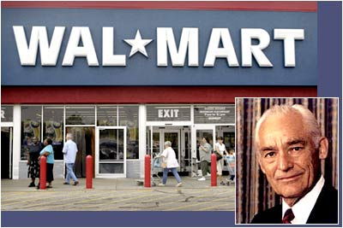
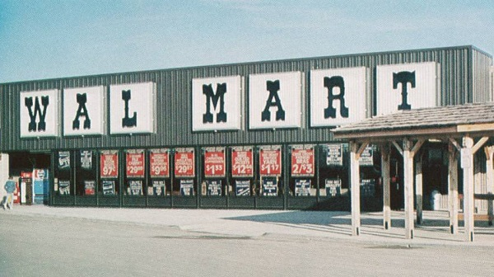

Slide 5
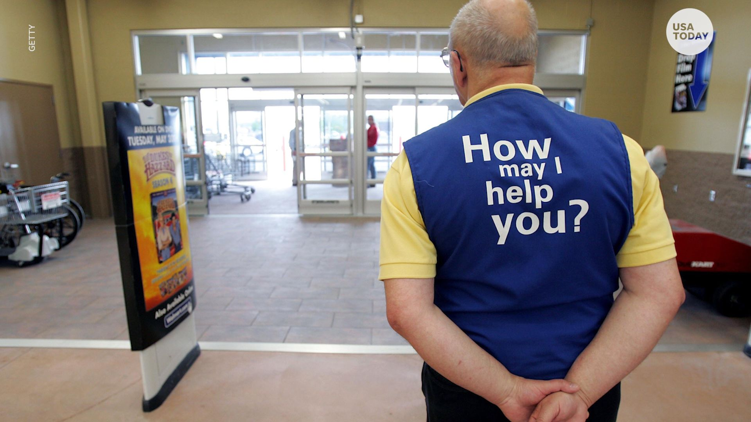

Slide 6
Sam Walton & Wal-mart cont…
Low prices are not what made Wal-Mart successful!
Sam Walton had a deeper cause or belief that drove him.
He believed in PEOPLE → if he looked after people, people would look after him.
The more Walmart could give to employees, customers and the community, the more that employees, customers and the community would give back to Walmart.

Slide 7
low-cost shopping model
Sam Walton did not invent the low-cost shopping model → was already a $2 billion industry when he decided to build the 1st Wal-Mart
Sam admitted to borrowing many ideas about business from another retail discounter from Southern California

Slide 8
low-cost shopping model cont…
Price is a highly effective manipulation BUT… does not inspire people to root for you and give you the undying loyalty

Slide 9
What started happening to Wal-mart?
Wal-Mart was WHAT Walton built to serve his fellow human beings. To serve the community, to serve employees and to serve customers → Service was a higher cause.
Problems:
His cause was not clearly handed down after he died.
Wal-Mart slowly started to confuse WHY it existed—to serve people—with HOW it did business—to offer low prices → motivation became selling things for cheap

Slide 10
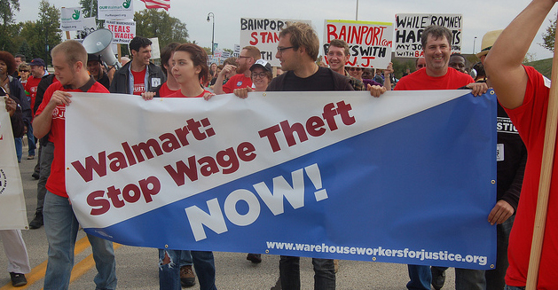
What started happening to Walmart? Cont…
Scandal-ridden for nearly a decade → every scandal has centered on how poorly they treat their customers and their employees.
Wal-Mart faced seventy three class-action lawsuits related to wage violations

Slide 11
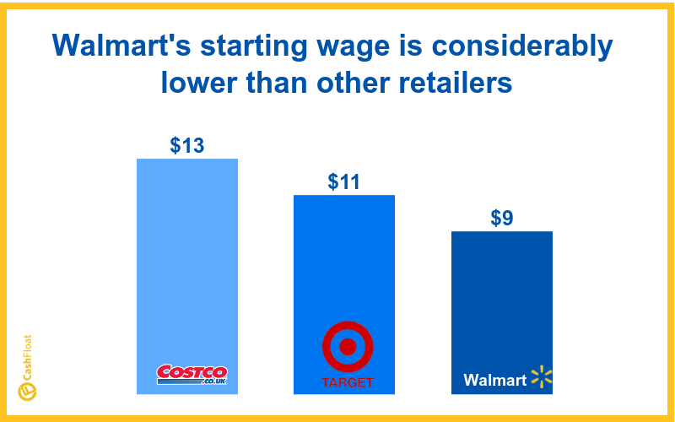
What started happening to Walmart? Cont…
Wal-Mart’s WHY started to go FUZZY (unclear) → WHAT they do and HOW they are doing it; hasn’t changed BUT they went from a company once so loved to one that isn’t anymore

Slide 12
Being Successful vs. Feeling Successful
Sinek attends a gathering of successful entrepreneurs (Gathering of Titans)
Someone ask the group how many of them had achieved their financial goals → 80 percent of the hands went up.
Someone then asks, “How many of you feel successful?” → 80 percent of the hands went down.

Slide 13
Being Successful vs. Feeling Successful cont…
Sinek didn’t understand why a room full of multimillionaires and some one America’s brightest entrepreneurs still didn’t feel like they succeeded
As their tangible success grew, they began to miss something.
Every single one of these successful business owners knew WHAT they did. They knew HOW they did it. But for many, they no longer knew WHY.

Slide 14
What is the difference between Achievement and Success?
Discuss in the groups and come up with your own definitions.

Slide 15
Achievement vs. Success
Achievement: is something you reach or attain, like a goal. It is something tangible, clearly defined and measurable. Achievement comes when you pursue and attain WHAT you want.
Success: is a feeling or a state of “being.” Success comes when you are clear in pursuit of WHY you want it.

Slide 16
Achievement vs. Success cont…
“In the course of building a business or a career, we become more confident in WHAT we do. We become greater experts in HOW to do it. With each achievement, the tangible measurements of success and the feeling of progress increase. Life is good. However, for most of us, somewhere in the journey we forget WHY we set out on the journey in the first place.”

Slide 17
Please discuss the following passage. What is Simon Sinek trying to say?
“For great leaders, The Golden Circle is in balance. They are in pursuit of WHY, they hold themselves accountable to HOW they do it and WHAT they do serves as the tangible proof of what they believe. But most of us, unfortunately, reach a place where WHAT we are doing and WHY we are doing it eventually fall out of balance.”

