Slide 1
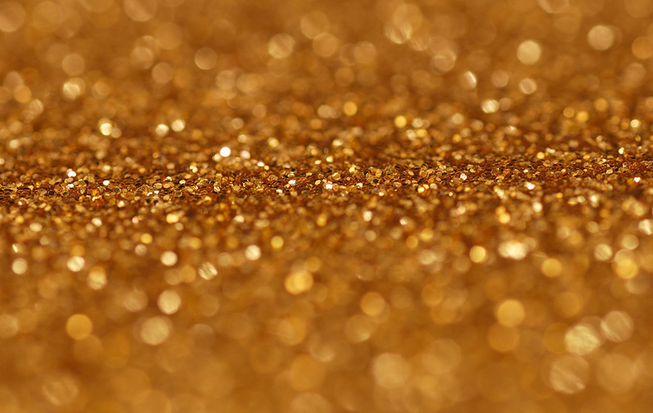
Start with why- By: Simon Sinek
THE GOLDEN CIRCLE
Professor Oumama Kabli
April 16, 2019

Slide 2
Question(s) of the day
Welcome back!
1. What year of your life has been your favorite so far?
2. What is one thing in your life that you couldn’t live without?

Slide 3
How do great leaders inspire action ?
Leaders choose to inspire rather than manipulate in order to motivate people.
Whether individuals or organizations, every single one of these inspiring leaders thinks, acts and communicates exactly the same way
Leaders to this consciously by following → THE GOLDEN CIRCLE
Golden Circle → inspired by the concept of the GOLDEN RATIO (offers a formula that can produce repeatable and predictable results)

Slide 4
What does the Golden Circle do?
The Golden Circle finds order and predictability in human behavior.
It helps us understand why we do what we do.
The Golden Circle → evidence of how much more we can achieve if we remind ourselves to start everything we do by first asking why.
Examples: Apple, Harley Davidson, Southwest Airlines
***The Golden Circle shows how these leaders were able to inspire action instead of manipulating people to act.

Slide 5
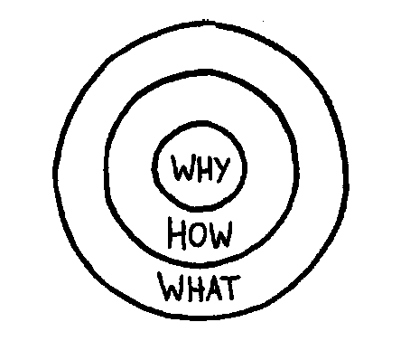

Slide 6
what
Every single company and organization on the planet knows WHAT they do.
No matter how big or small, no matter what industry. Everyone is easily able to describe the products or services a company sells or the job function they have within that system.
These are products they sell or the services they offer.
***WHATs are easy to identify.

Slide 7
How
Some companies and people know HOW they do WHAT they do.
HOWs are often given to explain how something is different or better.
These are the things that make them special or set them apart from their competition
***Not as obvious as WHATs

Slide 8
Why
Very few people or companies can clearly articulate WHY they do WHAT they do.
WHY → what is your purpose, cause or belief? WHY does your company exist? WHY do you get out of bed every morning? And WHY should anyone care?
**WHY is not about making money. That’s a result. It’s a purpose, cause or belief. It’s the very reason your organization exists

Slide 9
THE GOLDEN CIRCLE
Most companies today (everyone else)
WHY
HOW
WHAT

Slide 10
Apple, if they were like everyone else
We make great computers. They're beautifully designed, simple to use and user-friendly. Wanna buy one?

Slide 11
THE GOLDEN CIRCLE
WHY
HOW
WHAT

Slide 12
THE GOLDEN CIRCLE
Example: Apple
WHAT
HOW
WHY

Slide 13
How apple actually communicates
Everything we do, we believe in challenging the status quo. We believe in thinking differently.
The way we challenge the status quo is by making our products beautifully designed, simple to use and user-friendly.
And we happen to make great computers. Wanna buy one?

Slide 14
Apple Example cont…
Apple's ability to design such innovative products so consistently
Their ability to command loyalty for their products comes from more than simply WHAT they do!!!

Slide 15
People don't buy WHAT you do, they buy WHY you do it.
What does this mean?
Apple commercial 1984:
https://www.youtube.com/watch?v=2zfqw8nhUwA

Slide 16
Ipod example
Apple did not invent the mp3 or the technology that became the iPod, yet they are credited with transforming the music industry → actually created by Creative Technology Ltd
Creative → advertised their product as a "5GB mp3 player”
Apple → advertised "1,000 songs in your pocket."
Creative told us WHAT their product was
Apple told us WHY we needed it.

Slide 17
Without first understanding WHY
The concept of "better": based on what standard?
Is a Ferrari F430 sports car better than a Honda Odyssey minivan?
A company doesn't need to have the best products, they just need to be good or very good. Better or best is a relative comparison.

Slide 18
Conclusions
Knowing your WHY is not the only way to be successful, but it is the only way to maintain a lasting success
When a WHY goes fuzzy, it becomes much more difficult to maintain the growth, loyalty and inspiration that helped drive the original success.

Slide 19
Simon sinek on the golden circle- TED Talk
https://www.youtube.com/watch?v=l5Tw0PGcyN0

Slide 20
Discussion Questions
The inner, smallest ring of the Golden Circle is the why, what Sinek describes as your “purpose, cause, or belief.” He says that this is the one that few know, and it’s not just profit. The educational equivalent of profit is a grade. If we remove that as a “why,” then what is a why for you with regard to school? If there were no grades, what would lure you to education?
According to Sinek, most businesses go from the outside in, whereas inspired leaders go from the inside out (they start with their “why”). What makes this important? What does it matter if you start with what or start with why?

