Slide 1
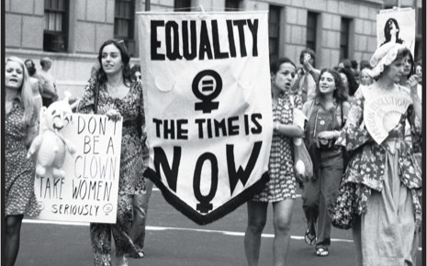
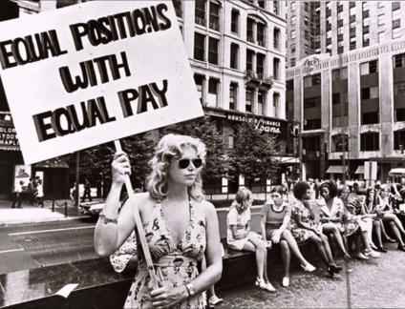
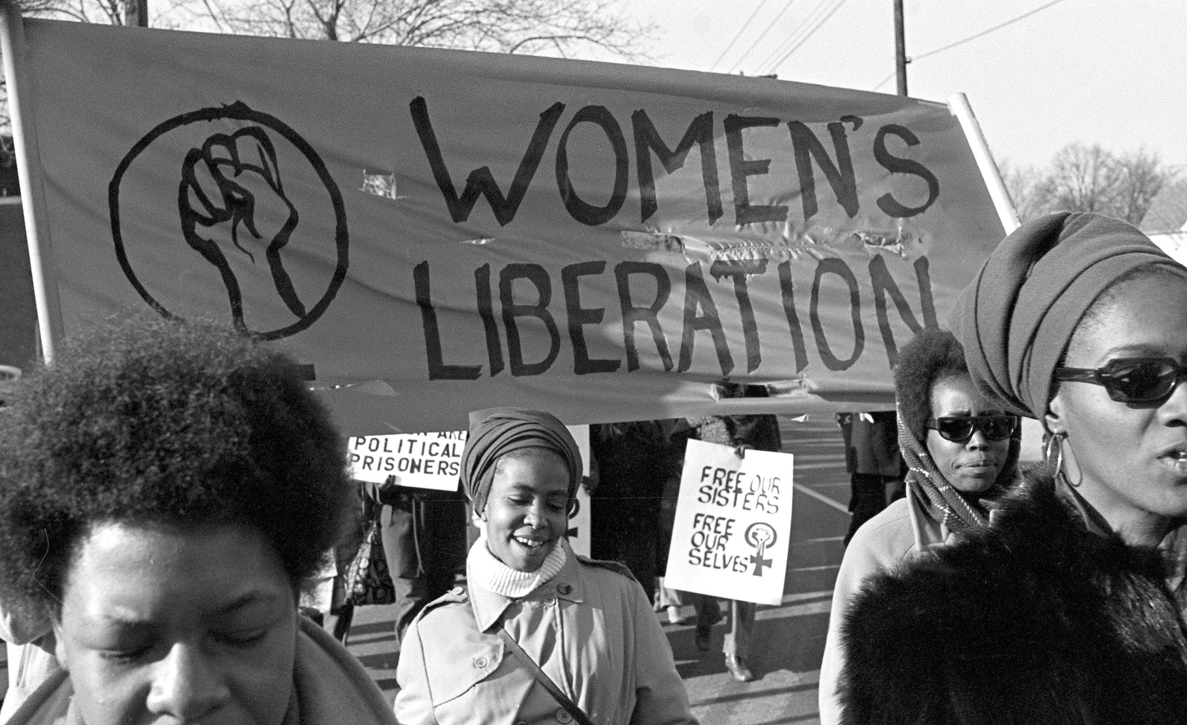
Civil Rights Movements (Gender)
Professor Oumama Kabli
October 29, 2018

Slide 2
Waves of Feminism
The first wave of feminism refers to 1830 to early 1900s.
The second wave refers to 1960s to 1980s.
The third refers to the 1990s to present day.
Each wave of the movement focused on different issues facing women in America and each wave has successes and failures that contributed to the story of the female struggle for equality in America.

Slide 3
First Wave of Feminism
First-wave feminism is also known as the Suffragette Movement. The first movements made towards equality in the 1800s and early 1900s were made to establish equal political power for women.

Slide 4
First Wave of Feminism cont…
Women during these time also sought to be acknowledged as independent beings from their husbands.
The key arguments of the first wave of feminism were to fight the denial of wages, money and property to married women, to fight the lack of access to education and professional careers and to fight the lesser status assigned to women in almost every arena of public and private life.

Slide 5
The Seneca Falls Convention
The Seneca Falls Convention began on July 19, 1848 in New York, making history as the first women’s right convention ever held.
The two-day convention saw the creation of the Declaration of Sentiments, which was styled after the Declaration of Independence. This women’s declaration outlined the grievances of women across the country and declared that all men and women are created equal.
It was written by Elizabeth Cady Stanton and Lucretia Mott.

Slide 6
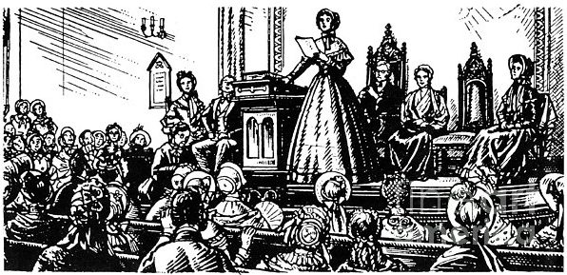

Slide 7
Declaration of Sentiments - Quotes
The second paragraph is similar the 1776 Declaration of Independence document, adding "women" to "men."
The text begins: "We hold these truths to be self-evident: that all men and women are created equal; that they are endowed by their Creator with certain inalienable rights; that among these are life, liberty, and the pursuit of happiness; that to secure these rights governments are instituted, deriving their just powers from the consent of the governed."
4. He has never permitted her to exercise her inalienable right to the elective franchise.
5. He has compelled her to submit to laws, in the formation of which she had no voice.
9. He has taken from her all right in property, even to the wages she earns.
14. He has denied her the facilities for obtaining a thorough education, all colleges being closed against her.
15. He allows her in Church, as well as State, but a subordinate position, claiming Apostolic authority for her exclusion from the ministry, and, with some exceptions, from any public participation in the affairs of the Church.

Slide 8
Criticisms of the Declaration of Sentiments
The whole document and event was met at the time with widespread disgust and mocking in the press, for even calling for women's equality and rights.
The mention of women voting, and the criticism of the Church, were mocked.
The Declaration has been criticized for its lack of mention of those who were enslaved (male and female), for omitting mention of Native women (and men)

Slide 9
Elizabeth Cady Stanton
Women's rights activist and abolitionist.
Elizabeth began to work and campaign for women's suffrage.
In 1869, Elizabeth and her good friend Susan B. Anthony formed the National Woman Suffrage Association.
They believed strongly that women should be given the right to vote. They thought that the Fifteenth Amendment, which gave black men the right to vote, should also include the right for women to vote.

Slide 10
Second Wave of Feminism
Second-wave feminism is also known as the Women’s Liberation Movement.
The second wave made strides towards equality in the 1960s to 1980s. It fought for female equality in the professional and domestic spheres, family and reproductive rights and for freedom of female sexual expression.

Slide 11
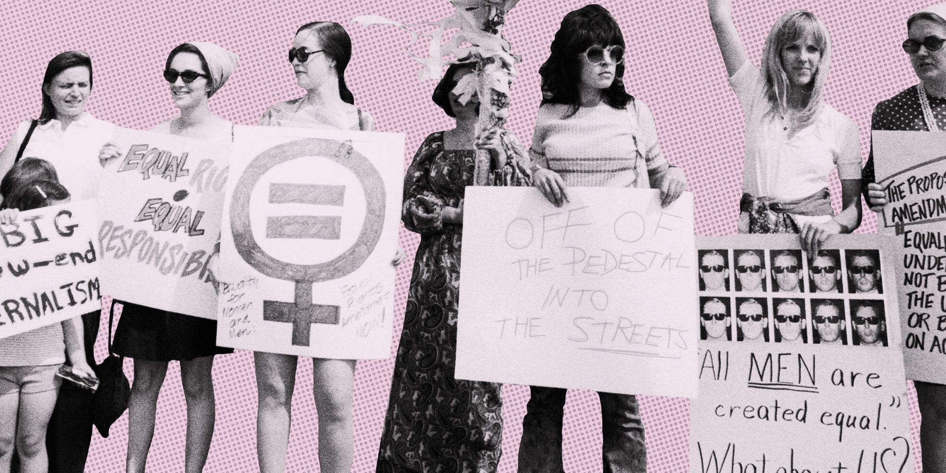
The Women’s Liberation Movement
It’s goal was to free women from oppression and male supremacy.
The movement consisted of women's liberation groups, advocacy, protests, feminist theory, and a variety of diverse individual and group actions on behalf of women and freedom.

Slide 12
Second Wave of Feminism cont…
Women during this time disagreed with the “nuclear family” as the ideal situation for women.
They also fought to banish the unjust treatment of women in the workplace, in school and in their personal lives. Additionally, women tried to secure divorce rights and legalize abortion.
Liberals and conservatives found themselves united in the fight for women, but divided on different social issues.
Also, the second wave of feminism argued that sex and gender were independent of each other. Sex, to them, was biologically defined while gender was socially defined.

Slide 13
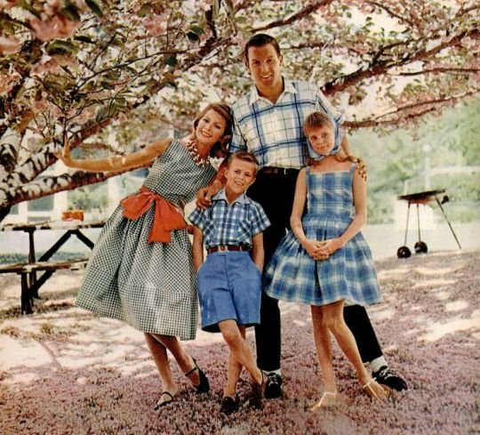
The Nuclear Family
The traditional definition of a nuclear family is a family unit that includes two married parents of opposite genders and their biological or adopted children living in the same residence.
How has the image of the nuclear family changed today?

Slide 14
Equal Rights Feminism
Focuses on the basic similarities between men and women, and whose ultimate goal is the equality of the sexes in all domains.
This includes economic and political equality, equal access within the workplace, freedom from oppressive gender stereotyping.
The equal-rights feminists were largely white, older in age, and most came from affluent backgrounds.

Slide 15
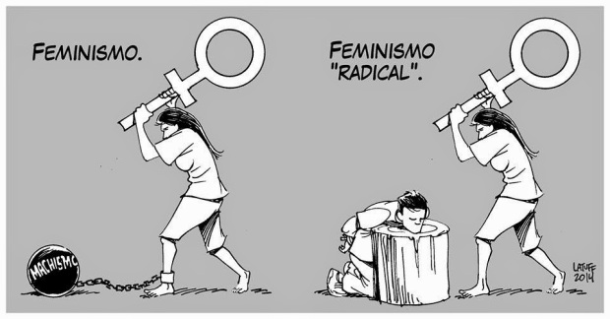
Radical Feminism
Radical feminism is a philosophy emphasizing the patriarchal roots of inequality between men and women, or, more specifically, the social domination of women by men.
Radical feminism views patriarchy as dividing societal rights, privileges, and power primarily along the lines of sex, and as a result oppressing women and privileging men.
Radical feminists were made up younger white affluent women, and minority women of all ages who were active in the Civil Rights movement.

Slide 17
Key Issues
Reproductive rights for women, including freedom to make choices to give birth, have an abortion, use birth control, or get sterilized.
Evaluating and then breaking down traditional gender roles in private relationships as well as in public policies.
Understanding pornography as an industry and practice leading to harm to women
Understanding rape as an expression of patriarchal power, not a seeking of sex.
Understanding prostitution under patriarchy as oppression of women, sexually and economically.
A critique of motherhood, marriage, the nuclear family, and sexuality, questioning how much of our culture is based on patriarchal assumptions.

Slide 18
Court Cases during the Second Wave
The Equal Pay Act of 1963 saw the “end” of discrimination in the work place based on sex.
The Supreme Court ruling of Griswold v. Connecticut in 1965 saw the legalization of birth control for married couples.
In 1972, the Supreme Court case Eisenstadt v. Baird saw the legalization of birth control for the unmarried.
The 1973 Supreme Court case Roe v. Wade legalized abortion in the United States and ended up being one of the greatest victories for women during this time.

Slide 19
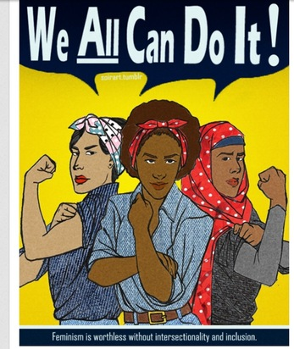
Minorities and Feminism
Women of color found themselves underrepresented in both the racial and gender movements that were fighting for greater equality.
Black, Latina/Chicana, Asian, and Native American women were active in feminist agendas at the time, but there were tensions within the broader feminists movements because a large percentage of the leaders were white.
Some non-white feminists criticized the wider feminist movement for failing to be equal in the movement's representation and incorporating racial and other issues.
Do white women and minority women face the same problems? Why?

Slide 20
Third Wave of Feminism
Third-wave feminism is also known as the movement for Global Feminism. Starting in the 1990s and continuing to present-day, the third wave has pushed the boundaries on what it means to fight for the rights and equality of the sexes around the world.
Third-wave feminism fought to end the marginalization of women, the systemic violence, oppression and sexual abuse of women and men around the world.

Slide 21
Third Wave Feminism cont…
It also sought to bring unity to divided feminist “parties.” Celebrating women in history and the acknowledgement of the body of work of women in academia, music, cultural movements and history were also major focuses of the third wave.
Third-wave feminism is a unifying and inclusive movement that champions individuality. The third wave is about finding an individual place in a larger crusade.

Slide 22
Feminist Movements Today
#MeToo Movement (is a movement against sexual harassment and sexual assault)
SlutWalk (transnational movement of protest marches calling for an end to rape culture, including victim blaming and slut shaming of sexual assault victims.)
LGBTQ Rights
Women’s March
Body Positivity

Slide 23
Debate Questions
What kind of feminism is more apparent today? (equal or radical?)
Are women and men really equal? Will they ever be equal?
Do women have the same rights as men in the US in comparison to Morocco?

Slide 24
Sources
https://www.ducksters.com/history/civil_rights/elizabeth_cady_stanton.php
https://www.entitymag.com/shattering-glass-history-womens-liberation-movement-america/
https://www.thoughtco.com/womens-liberation-movement-3528926
https://www.thoughtco.com/seneca-falls-declaration-of-sentiments-3530487
http://womenshistory.info/declaration-sentiments-1848-womens-rights-convention/
https://en.wikipedia.org/wiki/Equality_feminism
https://family.lovetoknow.com/definition-nuclear-family
https://www.thoughtco.com/what-is-radical-feminism-3528997
https://dailyhistory.org/What_was_the_Second_Wave_Feminist_Movement%3F

Slide 25
Homework
Please watch the following YouTube video about political parties and take notes. We will discuss it next class!
https://www.youtube.com/watch?v=VEmOUHxessE

