Slide 1
Impromptu speeches and accents
Professor Oumama Kabli
February 27, 2019

Slide 2
Logistics- groups and Sign-ups
If you have not communicated to me who is in your groups, your topic, and choice of format, please do so IMMEDIATELY. Today I would like to get topics and groups FINALIZED!!! I would also like to start posting the group presentations on the website ASAP!

Slide 3
Grading Rubric
The grading rubric for your oral presentations/debates has been finalized!
Please makes sure that you are adhering to the rubric as best as you possibly can when giving your presentations!
Presentations will be randomly decided. One representative from each group will write their name on a piece of paper and I will pick randomly from the pile of papers who will be presenting on their respective day.

Slide 4
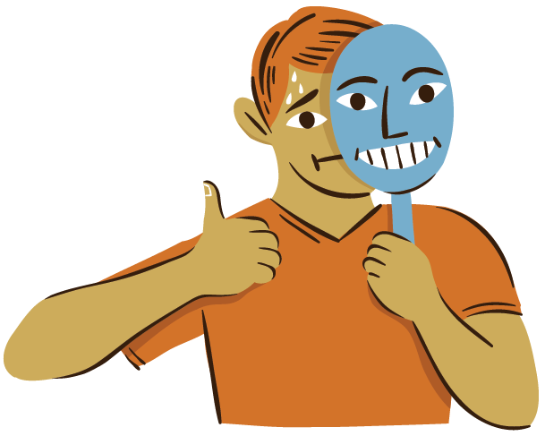
What is an impromptu speech?
An impromptu speech is when you’re asked to speak in public without prior notice or little to no preparation.

Slide 5
Advantages
You are generally in control of the content you are presenting, so you can include topics that you want to talk about.
You can use personal examples from experience to support what you are saying. Since you are an authority on the topic, you want to speak with conviction like you really mean it.
Your delivery will naturally be more conversational and spontaneous. Since you are not prepared with pages of notes, you are more likely to speak directly to the audience just like if you were speaking to another person in a conversation.

Slide 6
disadvantages
You may have difficulty thinking of what to say or formulating the ideas once you get up to speak.
Although you are familiar with the topic, your speech may lack details and supporting information.
Impromptu speaking is rarely appropriate for occasions which require more supporting ideas or reasoning.

Slide 7
Tips for the speaker (impromptu speaking)
Make a few notes for yourself on a card, phone, or iPad. Or, text yourself a few single words to remind yourself of the important ideas.
Consider the simple three part outline of an Introduction, Body, and Conclusion, and fit your ideas into that pattern.
Do not try to remember a detailed outline for your entire speech; just remember the order of important points.
If you do not know what to say next, you can summarize and paraphrase what you have just said, and then will probably be ready to move on to the next topic.

Slide 8
When might you use impromptu speech?
Introducing yourself at networking events.
Filling in for a late speaker.
You are asked to give a toast at a company party.
You get asked a question you did not prepare for while on a panel.
Job interview questions
You are interviewed by a reporter.
You get pulled into a meeting to give an update.
There is unexpected push back on your ideas at a company meeting.
Say a goodbye speech to a departing employee.

Slide 9
Tips for the speaker (impromptu speaking) cont…
Remember that, in most situations, you will know more about the subject than the audience.
Usually you will not be called up to speak impromptu about something you know nothing about, so you have probably spoken about the general topic before or you probably have knowledge to share with others.
Talk like you mean it. In other words speak with conviction. You are explaining your ideas or knowledge and you are an authority. (FAKE IT ‘TILL YOU MAKE IT)
RELAXXXXXXX!

Slide 10
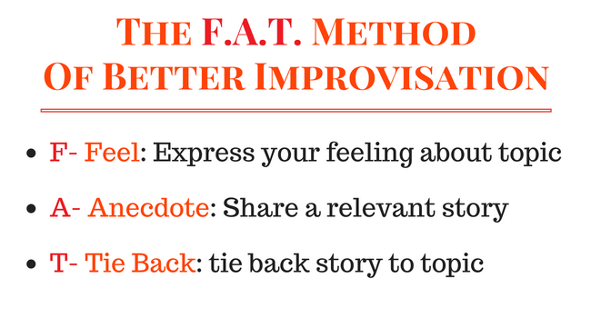

Slide 11
What is an accent?
An accent is the unique way that speech is pronounced by a group of people speaking the same language.
Regional Accents – for example, people who are from Texas often sound different than people who are from New York.
Foreign Accents – for example, someone who was raised speaking English will sound different than someone who was raised speaking Spanish and learned English as an adult.

Slide 12
How do accents affect communication?
People not understanding you
Avoiding social interaction with those who may not understand you
Frustration from having to repeat yourself all the time
People focusing on your accent more than on what you are trying to say

Slide 13
Improving your English speaking
Always try and speak slowly and clearly making sure you pronounce all the syllables (part of a word we pronounce) in every word.
Listen to how the voices of native English speakers rise and fall. Intonation refers to the ‘music of your voice’ whereas stress refers to the ‘rhythm of the word’.

Slide 14
Tongue twisters
Purple paper people. Purple paper people. Purple paper people.
I have got a date at a quarter to eight. I’ll see you at the gate, so don’t be late.
A box of mixed biscuits. A mixed biscuit box.
If 2 witches were watching 2 watches, which witch would watch which watch?

Slide 15
Let’s guess the accent!
https://qz.com/259129/quiz-can-you-guess-the-accent/

Slide 16
Sources
https://lumen.instructure.com/courses/218897/pages/linkedtext54267
https://magneticspeaking.com/how-to-give-an-impressive-impromptu-speech/
http://wisdomspeechtherapy.com/how-do-accents-affect-communication/

