Slide 1
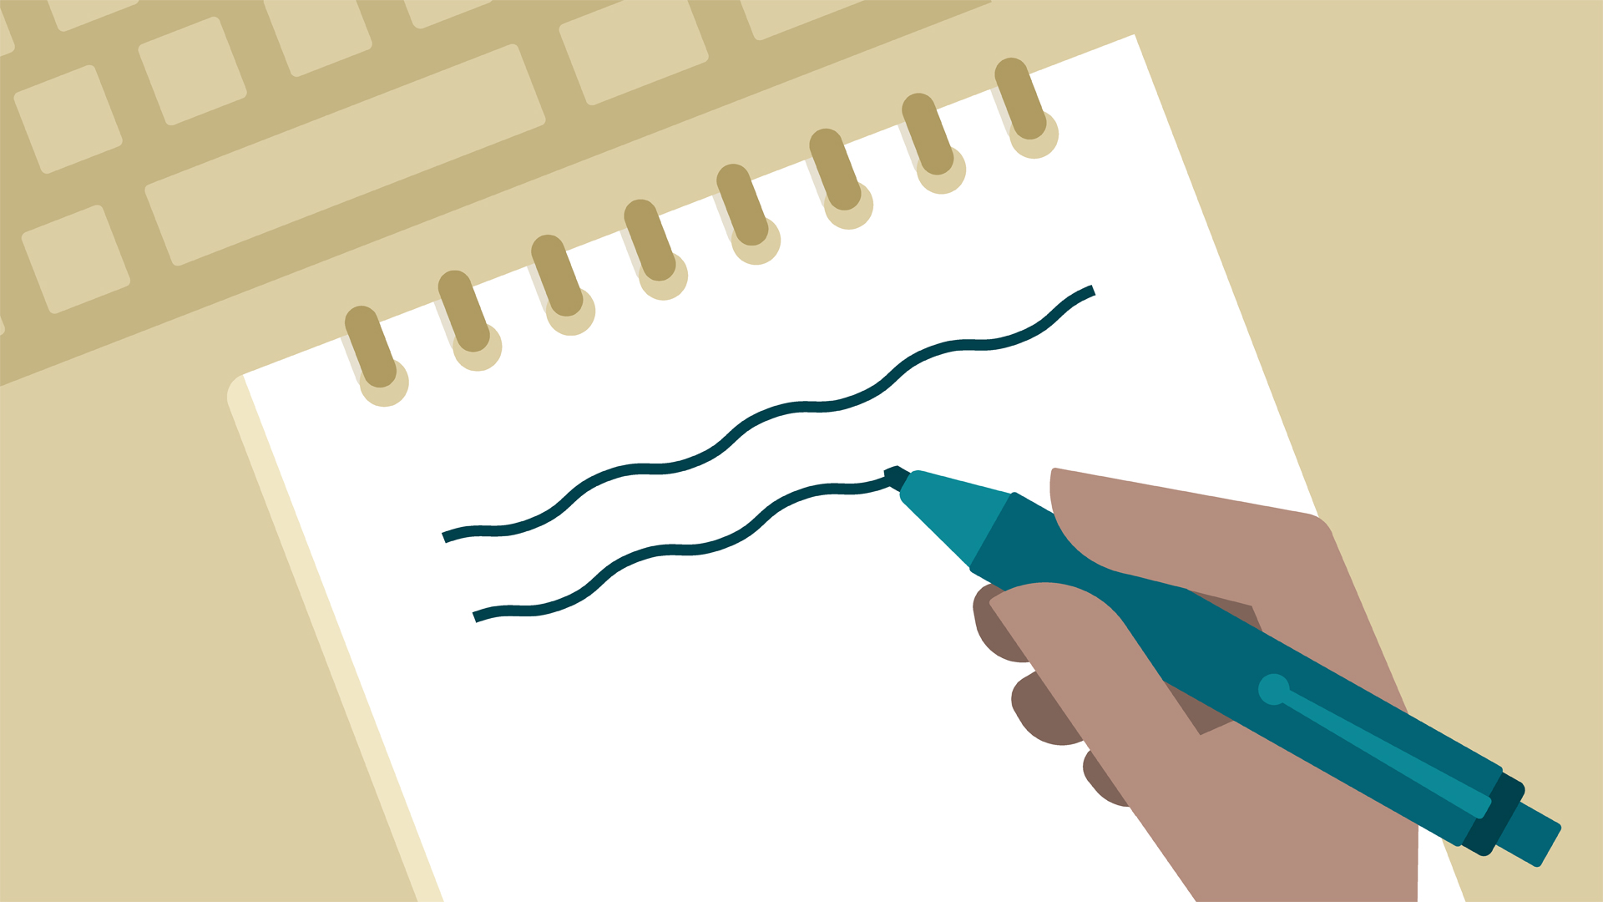
Note-taking
Professor Oumama Kabli
October 24, 2018

Slide 2
Did you know?
Your brain will undergo a perfectly normal “leakage” in short-term memory of about 80 per cent in 24 hours.
This means you will hold in your short-term memory only about 20 per cent of the content of any lecture one day later.
The “leakage” will continue as time progresses, meaning that your recall could well be next to nothing by exam time.

Slide 3
Obtain a syllabus for every subject being studied
The syllabus will include the weeks when the topics will be covered and recommended readings in key references.
An important feature of the course syllabus is a guide to how you will be assessed. All of these features make the course syllabus a very important student resource to be used throughout the academic semester.

Slide 4
Warm up your mind before each lecture
The warming-up process is a short browse through the reference source.
The reference is very likely to be included in the syllabus. Find the chapter or section pertaining to the topics scheduled for the next lecture and run your eyes down each page.
Note any topic which is in bold-face print, italics, or is included as a section heading or title to a chart or graph.
You might also want to write the term in a notebook to remember it later on. (The whole warming-up process should take only about five to ten minutes.)
Another helpful tip is reviewing your notes from the preceding lecture, as lectures are generally presented in series, the present lecture will probably pickup where the previous one finished.

Slide 5
The structure of most lectures
Introduction: is presented at the very start of the lecture and generally comprises a brief overview of what will be discussed in the body.
It is a prime opportunity for you to warm up for the presentation. Your mind should be listening acutely for any mention of the terms and concepts.
It is also the time for you to be organizing the essential equipment which will be necessary to get a good set of notes (pens, pencils, notebooks, writing pads, etc.)
The Body: the body of most lectures will vary, depending on what is being taught.
Keep your mind on target by asking both analytical and selective questions. What is the meaning of this term? How does this concept relate to the one just presented? What causes this phenomenon to occur? What are the future implications or ramifications of this event?
The Summary: the conclusion of what has just been presented.
It is the prime opportunity to locate any areas of confusion or ask for further clarification on any concepts.

Slide 6
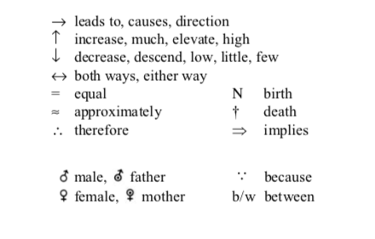
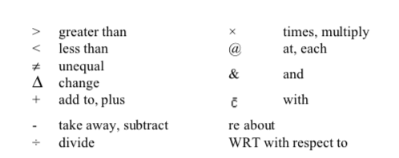
Note-taking speed
*Devise a range of symbols and abbreviations which allow you to take notes more efficiently.*

Slide 8
Practical Pointers for good lecture notes
Know what topics will be presented. Consult your syllabus and browse through the reference materials before each lecture.
Note the title of the lecture, the lecturer's name, and the date on the first page of your notes.
Number your pages in case they get out of order or lost.
Leave plenty of open space on each page for supplementary (extra) notes.
Organize your notes as you listen. If you prefer an outlining
Have several different colored pens available to make important points more prominent.
Make notes to yourself in the margins, such as: “Know for exams!” “Good essay question topic,” “Unclear. Get help.”
Be sure to note special diagrams, charts and graphs.

Slide 9
How to start
Always put the date and subject at the top of your notes.
This helps you stay organized.
Do NOT take notes on every word you hear.
You have to determine what information is most important based on how it is presented.
Take notes on what you don’t know If you already know something, you do not need to write it down!
Avoid complete sentences.
Summarize using short phrases and keywords.
Leave space between different ideas.
Use different colors, underline, bold, highlight things in order to distinguish and connect ideas with one another.
Develop a shorthand so you can write more quickly.
Eliminate vowels.
Use symbols and abbreviations.

Slide 10
Verbal cues
Pauses and repetition
Emphasis- loudness, slower speed
Phrases like:
To summarize…
Most importantly…
On the other hand…
As a result…

Slide 11
Nonverbal cues
Things written on the whiteboard.
Gestures.
Eye contact.

Slide 12
Reviewing your notes
Identify things you did not understand.
Write down questions you still have.
Look for specific terms and main ideas.
Think about how those terms and ideas fit into the big picture.

Slide 13
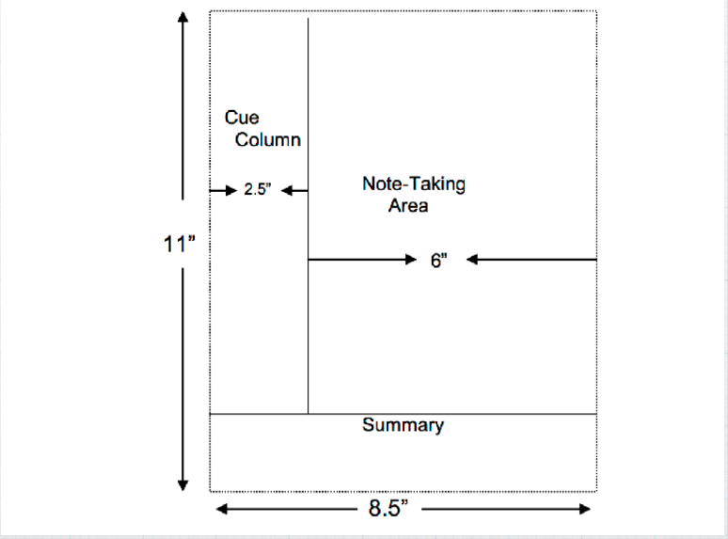
The Cornell note-taking system

Slide 14
Step 1: Divide your paper into 3 sections

Slide 15
Step 2: Document the Course Name, Date, and Topic at the top of the page

Slide 16
Step 3: Write your notes down with the key points on one side and notes on the other. Skip a line between different ideas and topics.

Slide 17
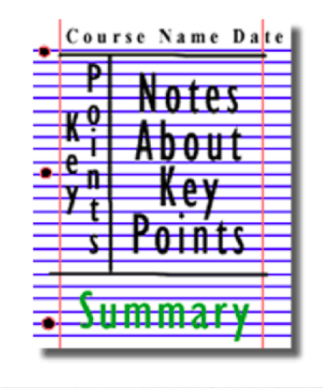
Step 4: Review and clarify your notes. Highlight main ideas, key points, dates, and people. Step 5: Use what you did in step 4 to write a summary of your notes at the bottom of the page.

Slide 18
The important thing is to be able to understand the main points and organize the information and your ideas in a way that makes sense to you.

Slide 19
Visual Note-taking

Slide 20
Ted talk: Visual note taking by Rachel Smith
Watch the following Ted Talk and use the Cornell Note-Taking System or the visual note-taking style. We will also discuss key concepts of the Ted Talk.
https://www.youtube.com/watch?v=3tJPeumHNLY
Notes:
Have students take notes on the Ted Talk using the Cornell Note-Taking System. Have the class discuss with groups what they learned from the talk or any important information they noticed. Discuss as a class.

