Slide 1
Reading More Efficiently
Professor Oumama Kabli
October 31, 2018

Slide 2
Class Activity
Write your first name, last name, section
What is your favorite book you’ve read (in any language) ?
Describe the main plot (in English)

Slide 3
Speed Reading
What is it?
Speed reading is a function of the number of eye fixations, or momentary stops, which you experience as you move your eyes across a line of writing.

Slide 4
Scanning
The process of scanning involves running your eyes down each page and taking note of any terms in bold-face print or italics, section headings, graphs and charts
Your eyes act only as the collectors of information — your mind must do the registering and analyzing.
Scanning is a preliminary process, an initial exposure without expectation of thorough understanding → You want to get the basic drift of the reading material and mentally note some of the important terms.
Make a note of the terms picked up by scanning. Remember, writing is a time-consuming task. Write the term, not a definition. Just the act of writing the term will help to record it in your memory.

Slide 5
Skimming

Slide 6
Scanning Techniques
Read the first sentence of each paragraph.
Use the Magnetic Technique. Think of your eyes as magnets and run them down the page.
Allow them to be drawn to bold-face print, italics, or any other terms which stand out from the surrounding text.

Slide 7
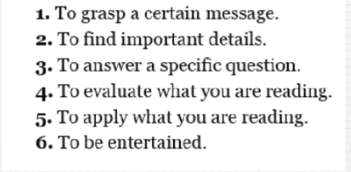
Reading to Learn and Retain Information
Use the SQ3R approach → Survey, Question, Read, Recite, Review.
Why are you reading? Why is having a purpose important?
What are clues your textbooks or readings give you to the structure of the reading? How can these help you?
Table of contents, introduction, footnotes, glossary, bibliography, appendices, index

Slide 9
Revision Reading for Exams
To maximize your learning, try to read and learn your lecture notes each weekend.
Strategically, the best way to approach your revision is to quickly survey all materials.
Look for items of prime importance — the highly examinable topics — and give them special attention. For example, arts and humanities subjects are generally best revised by reading over and over the notes many times.

Slide 10
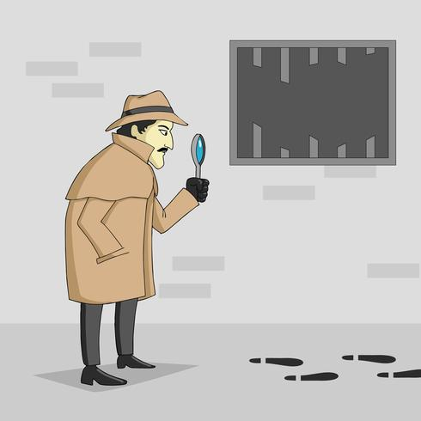
Word Clues
What are words that tell you when to speed up, slow down, or concentrate that will help you read faster?
Likewise, in addition, moreover, furthermore, etc.
Contradictory: On the other hand, nevertheless, however, rather, but
Payoff Words/ Highlights: to summarize, in conclusion, therefore, consequently, thus

Slide 11
Remembering Material
Evaluate the material and define your purpose
Choose reading techniques to use Identify the most important facts and ideas
Take notes
Review your notes and the readings, quiz yourself on the most important ideas
IMPLEMENT - find ways to use what you have learned in class, work, and personal life

Slide 12
Do’s & Don'ts of Reading
Do: Read with purpose (actively)
Write while you read—take notes, outline the text, underline, etc.
Make sure you understand—ask yourself questions, go back over important parts of the text
Don’t: Read passively Mark up a page randomly so it looks like you did the reading
Let yourself get distracted
Read too fast

Slide 13
Mapping What You Read
Once you’ve finished a reading using the SQ3R steps, reorganizing that information into a map can be useful for further understanding.
What do I mean by map? There are many types. You can use different ones depending on the kind of information you have from the reading.
Chart
Spider Chart
Venn diagram
Chain Trees

Slide 14
Simple Chart

Slide 15
Spider Chart

Slide 16
Chain

Slide 17
Trees

Slide 18
Venn Diagram

