Slide 1
Revision Skills
Professor Oumama Kabli
November 14, 2018

Slide 2
Lecture Revision
The most critical first revision is just after each lecture. At this point, the topics should be fresh in your mind.
Read through your notes and make any additions or corrections which you think are necessary. If you are confused about any topic, then consult your text or other references and make supplementary notes.

Slide 3
Weekend Learning
One of the most practical and beneficial steps to increase your learning potential and to maximize your marks is to revise each weekend.
Revision is a necessity and the research on learning methods is crystal clear — regular and spaced learning is far, far superior to last-minute cramming.
If your weekends tend to follow a set routine, try to find a three-hour period which you can dedicate solely to revision. → It is to be used only for revising, that is learning your notes and other materials. Pull out the lecture notes and any other resources which have been generated during the last week.

Slide 4
Revision for Quizzes and Tests
Consult your syllabus and take special note of any comments made about assessments.
Note particularly the different types of quizzes, tests and examinations which are scheduled (or those which may be administered without prior warning). Ask whether there may be multiple-choice sections and/or short answer questions; mathematical problems; and major essay questions.
Plan for sufficient time to revise your lecture notes and other resources at least four to five times. Repetition is a great teacher, but repetition takes a lot of time!

Slide 5
Revision for Quizzes and Tests cont…
As you revise each lecture, ask yourself what are the three most examinable topics in this lecture. Note them briefly on a separate sheet for later consideration.
Meet with a classmate whose ability and commitment you respect and compare notes on these highly examinable topics. Discuss the topics you noted in common.

Slide 6
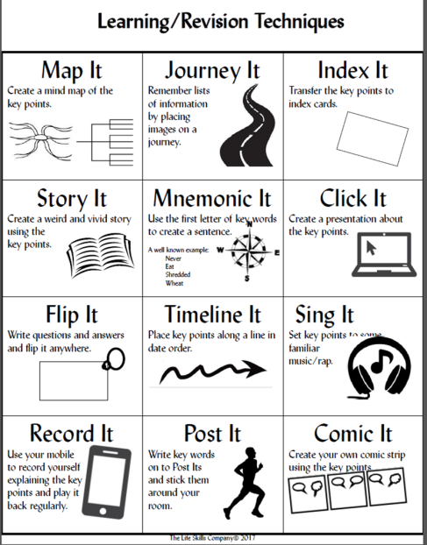

Slide 7
Early Morning Revision on Exam Day
Assuming that you have allowed sufficient time for some good sleep, an early morning revision will help to get your mind prepped for the exam.
That early morning session should be just a light scan of the notes. It certainly is not a time to confront a new and complex topic which you suddenly think is prime exam material.

Slide 8
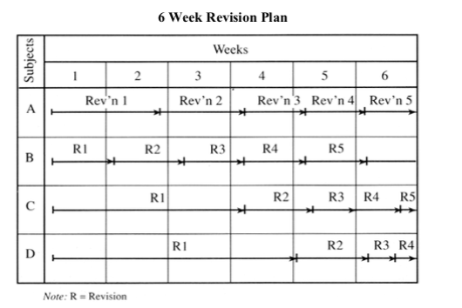
End of Year Exam Revision
In order to do full justice to your final exams, you will really need to schedule your revisions over a long period of time (6 week period).
You might want to chart the revision period and post it in a prominent place where you can easily see it.

