Slide 1
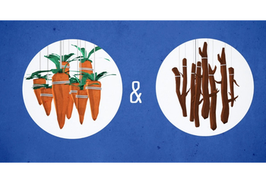
Introduction to Start with Why & Chapter 2: Carrots and Sticks
Professor Oumama Kabli
Friday April 5, 2019
Make-up Class

Slide 2
Introduction Comprehension questions Please answer these questions in groups
What does it mean to start with why?
What three people are used as examples of those who “started with why?”
What made Apple such a successful company?
Based on the context, what do you think the phrase, “There are leaders and there are those who lead.” (5)
What type of organization can start with why?
Why do you think the author listed Disney as a company that “starts with why” according to his definition?

Slide 3
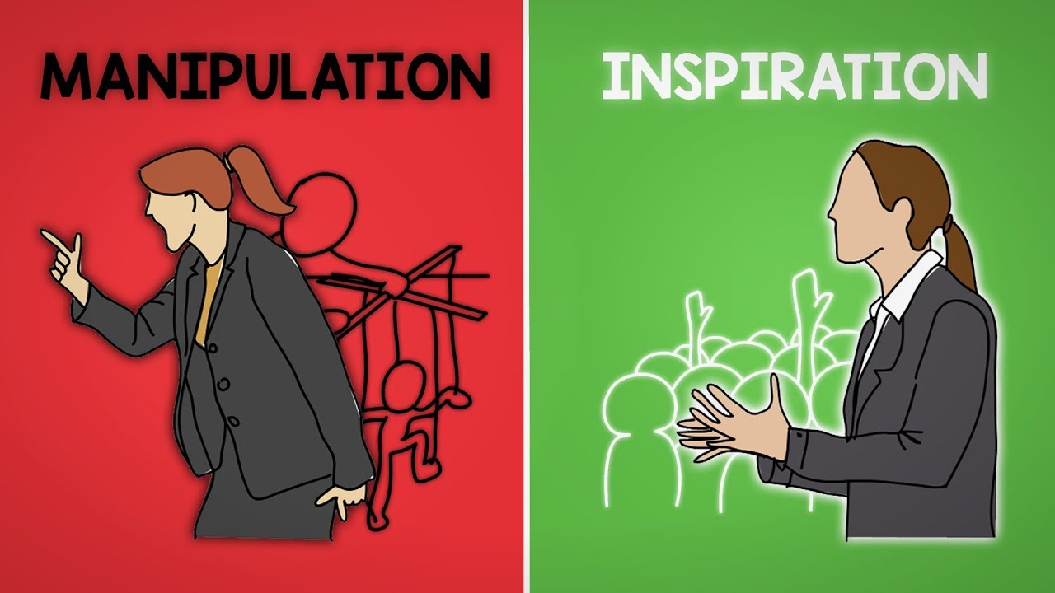
Manipulation vs. inspiration
Important points made:
most companies have no clue why their customers are their customers. (or employees) → how do they know how to attract more employees and encourage loyalty among those they already have?
There are only two ways to influence human behavior: you can manipulate it or you can inspire it.

Slide 4
Manipulation vs. inspiration cont…
In sales and marketing → tactics for manipulating:
dropping the price; running a promotion; using fear, peer pressure or aspirational messages; and promising innovation to influence behavior
When companies or organizations do not have a clear sense of why their customers are their customers, they tend to rely on a disproportionate number of manipulations to get what they need.

Slide 5
Price
price is a highly effective manipulation (Drop your prices low enough and people will buy from you)
Playing the price game is hard:
Sinek uses the example of drug addicts (Heroin) and selling based on price
The short-term gain is fantastic, but the more you do it, the harder it becomes to stop
Once buyers get used to paying a lower-than-average price for a product or service, it is very hard to get them to pay more.
As a result: It creates a need to sell more to compensate and of course, the easiest way to do that is to again → downward spiral of price addiction

Slide 6
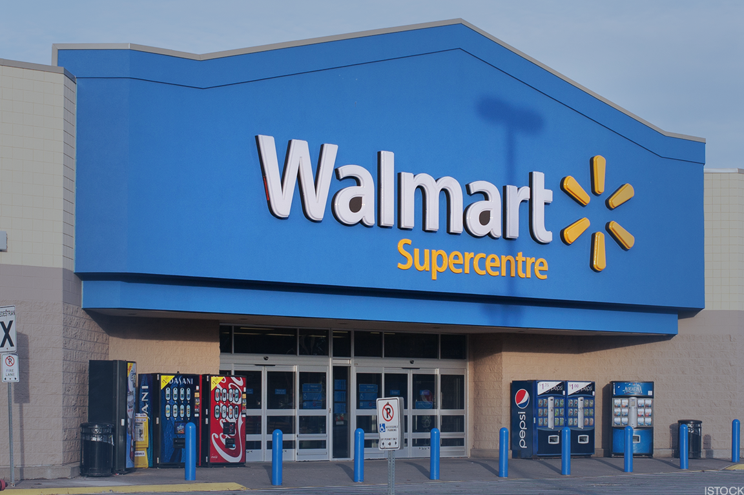
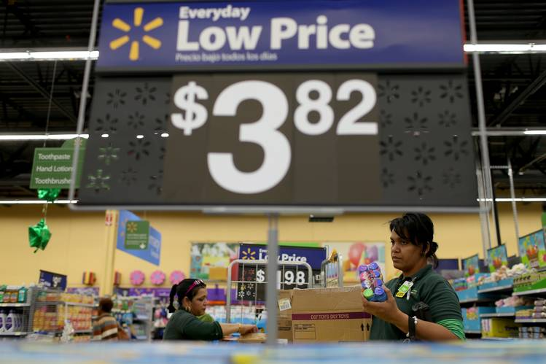
Price cont…
Example → Walmart is an exception to this rule because they have thrived on playing the price game BUT… it comes at a high cost → Walmart hurt its reputation as a result of attempts to keep cost down
Price always costs something.

Slide 7
promotions
"two for one" or "free toy inside” → promotions are common manipulations
promotions are called "value added."
give something away for free to reduce the risk so that someone will do business with you → as a result promotions work!
Promotions are well established in the industry of sales → one of its principles is named: Breakage
Breakage: Breakage measures the percentage of customers who fail to take advantage of a promotion and end up paying full price for a product instead.
When does this happen?
When customers do not take the steps to claim their rebates

Slide 8
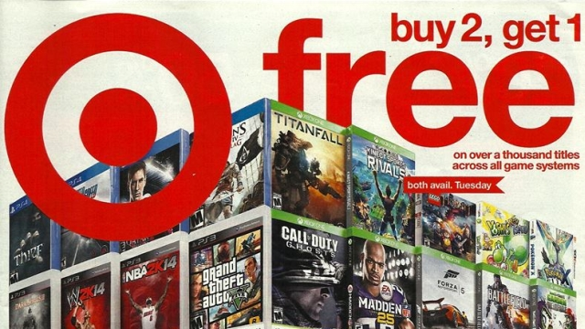

Slide 9
Promotions cont…
Rebates → require the customer to send in a copy of a receipt, cut out a bar code from the packaging and fill out a rebate form with details about the product and how it was purchased.
For businesses: a rebate lures customers to pay full price for a product that they may have considered buying only because of the prospect of a partial refund

Slide 10
fear
Fear, real or perceived, is the most powerful manipulation
Fear is regularly used in public service ads, say to promote child safety or AIDS awareness, or the need to wear seat belts.
For example:
https://www.youtube.com/watch?v=3FtNm9CgA6U
“If anyone has ever sold you anything with a warning to fear the consequences if you don't buy it, they are using a proverbial gun to your head to help you see the "value" of choosing them over their competitor.” – Simon Sinek
FEAR works!

Slide 11
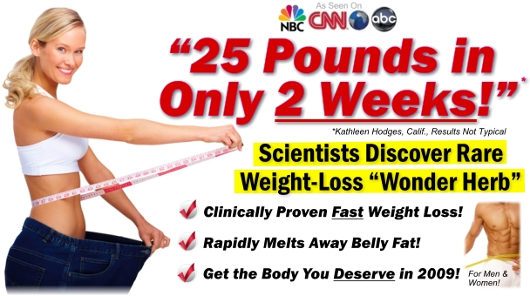
Aspirations
In the case of marketers: “offering someone something they desire to achieve and the ability to get there more easily with a particular product or service”
Examples:
"Six steps to a happier life."
"Work those abs to your dream dress size!"
"In six short weeks you can be rich."
these messages manipulate → tempt us with the things we want to have or to be the person we wish we were.
EXAMPLE: SOMEONE BUYING A GYM membership after the new year

Slide 12
Peer pressure
marketers report that a majority of a population or a group of experts prefers their product over another → attempting to sway the buyer to believing that whatever they are selling is better.
The peer pressure works! → we believe that the majority or the experts might know more than we do → we fear that we may be wrong.
For example: Celebrity endorsements
Gatorade's "I wanna be like Mike" campaign; grow up and be just like Michael Jordan if they (kids) drink Gatorade → impressionable youth
https://www.youtube.com/watch?v=b0AGiq9j_Ak
Pressure from a salesperson → make you feel you might be missing out on something or that everyone else knows but you

Slide 13
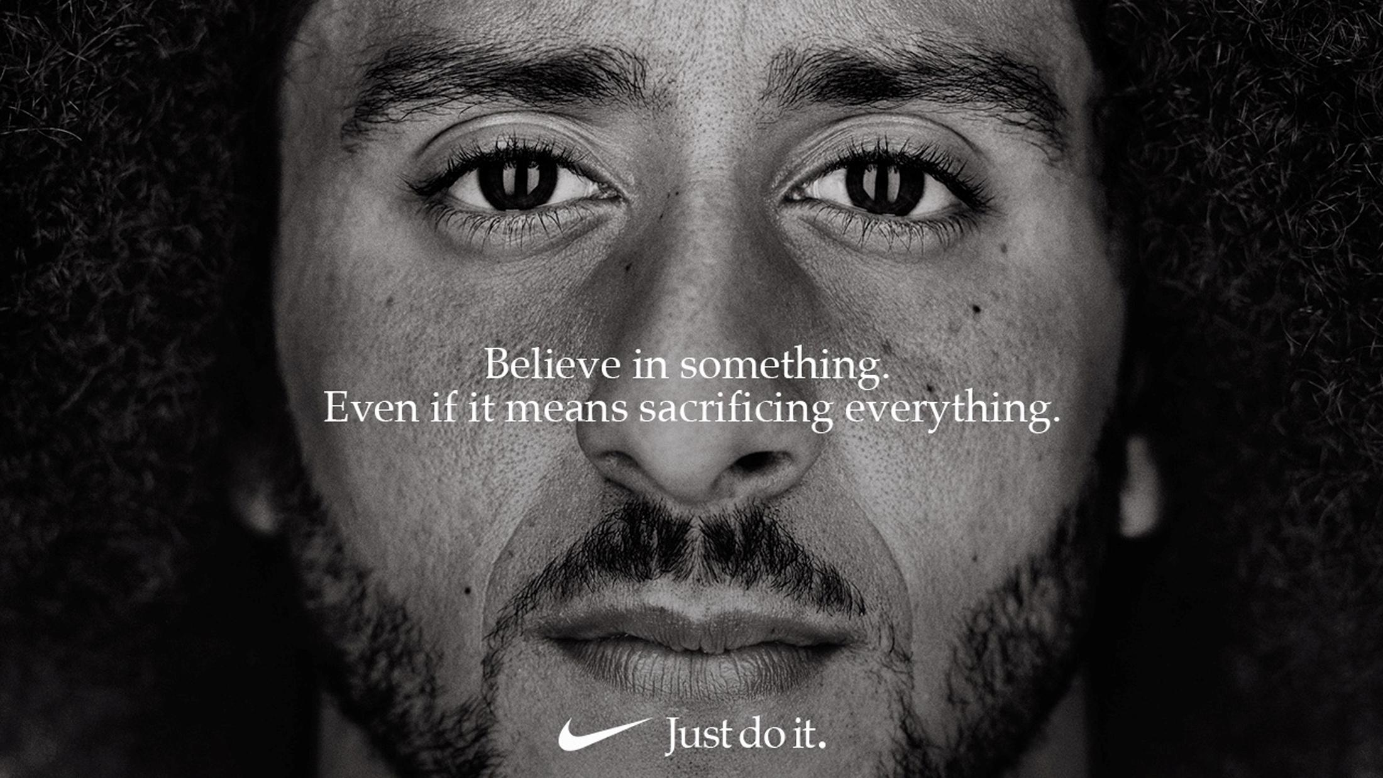

Slide 14
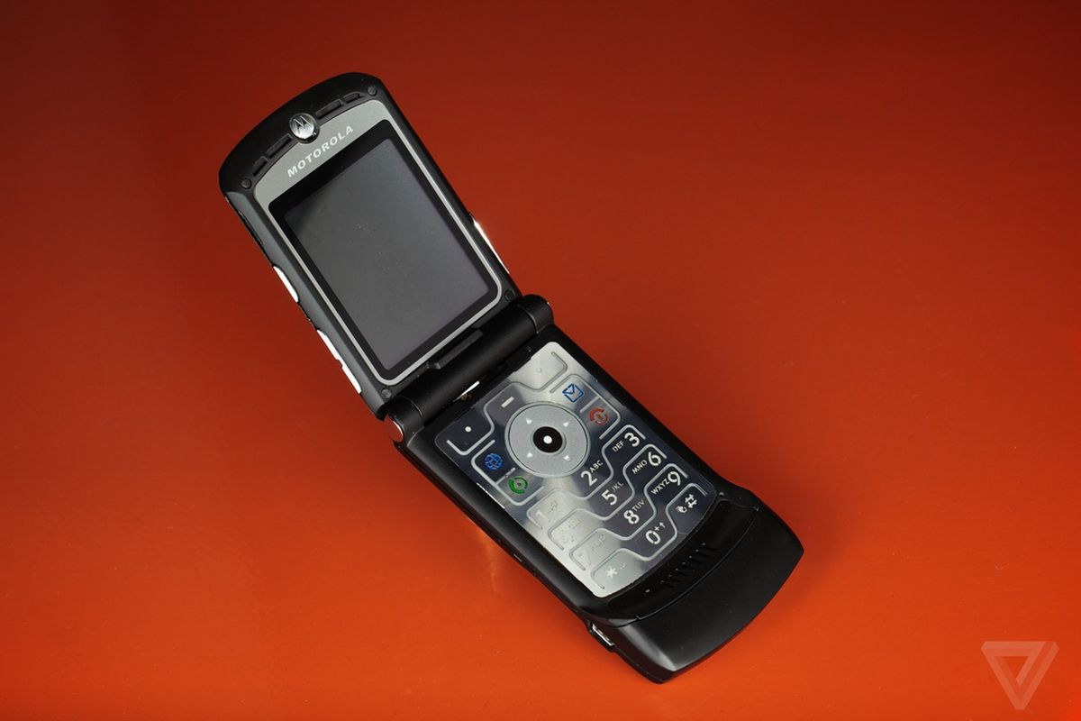
Novelty (a.k.a. Innovation)
Real innovation changes the course of industries or even society.
For example:
Motorolla and the RAZR phone
Motorola successfully designed the latest shiny object for people to get excited about → until a new shiny object came out.
these features are more a novelty than an innovation. They are added in an attempt to differentiate, but not reinvent.

Slide 15
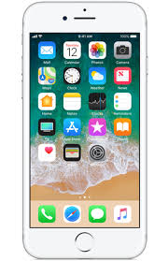
Novelty (a.k.a. Innovation) cont…
can't be counted on to add any long-term value.
Novelty can drive sales, but the impact does not last.
For Example:
Apple's iPhone has since replaced the Motorola RAZR
Apple is not only leading how mobile phones are designed, but, how the industry functions → what does this mean?

Slide 16
Manipulations Lead to Transactions, Not Loyalty
Manipulations do not breed loyalty → what does this mean?
Over the course of time, they cost more and more.
The gains are only short-term
they increase the level of stress for both the buyer and the seller
Don’t create a foundation or leadership (Leadership is the ability to rally people not for a single event, but for years)

Slide 17
Manipulations Lead to Transactions, Not Loyalty cont…
difference between repeat business and loyalty
Repeat business → when people do business with you multiple times
Loyalty → when people are willing to turn down a better product or a better price to continue doing business with you.
****Loyal customers often don't even bother to research the competition or entertain other options. Loyalty is not easily won. Repeat business, however, is.

Slide 18
Manipulations Lead to Transactions, Not Loyalty
For transactions that occur an average of once, carrots and sticks are the best way to elicit the desired behavior.
For example:
When the police offer a reward for a crime they are not looking to nurture a relationship with the witness; it is just a single transaction. What are examples of other single transactions?
Manipulations→ drive transactions, or any behavior that is only required once or on rare occasions.

Slide 19
Just Because It Works Doesn't Make It Right
manipulations work → they have become the norm, practiced by the vast majority of companies and organizations, regardless of size or industry.
With every price drop, promotion, fear-based or aspirational message, and novelty we use to achieve our goals → companies, organizations and systems getting weaker and weaker.

