Slide 1
The American Education System
Professor Oumama Kabli
November 19, 2018

Slide 2
Question of the Day
“Education is the most powerful weapon which you can use to change the world.” – Nelson Mandela
What do you think Nelson Mandela meant when he said this? How can education be powerful?

Slide 3
History-Early Education in the USA
● 1600s – only boys, only upper class
○ Mostly religious
● 1700s – growth of English Grammar Schools
○ Middle class students
○ Practical subjects like engineering, bookkeeping etc.
One room schoolhouse
● Slaves were not allowed to be educated

Slide 4
History- Early Education
Horace Mann – “Father of Common Education”
○ Massachusetts Board of Education in 1837
Wanted to create universal, secular education in the U.S.
His idea was that all kids should receive a basic education funded by local taxes

Slide 5
Education and Assimilation
Assimilation: “the process by which a person acquires the social and psychological characteristics of a group”
Native Americans educated by missionaries
● Boarding schools
“Americanization” for immigrants
Freedman’s Bureau promoted education for freed slaves after 1864

Slide 6
History- 20th Century Education
By 1918, all states passed compulsory school attendance laws
■ Began with MA in 1852
John Dewey – idea that learning can be used for social
reform (goal: informed citizens)
Segregation from 1860s-1960s – racial inequality
■ Brown vs. Board of Education

Slide 7
Grades/Ages
Pre-K – ages 2-4
Kindergarten – ages 5-6
Elementary School – grades 1-5 (ages 6-12)
Middle School – grades 6-8 (ages 12-14)
High School – grades 9-12 (ages 14-18)
College or University (ages 18-22)
■ 1) Freshman 2) Sophomore 3) Junior 4) Senior
Post-Baccalaureate/Masters/Doctorate Studies (ages 22+)

Slide 9
Religion and Education
Constant Debate!
Separation of Church and State
Secularism: “the belief that religion should not be part of the affairs of the state or part of public education. The principles of separation of church and state and of keeping religion out of the public school system are an example of secularism.”
Does this mean religion is not taught in schools?!

Slide 10
Religion & Education
Teaching about the Bible, the Quran, the Torah or other sacred texts and their influence on human behavior. No one denies that religion has strongly motivated behavior in the United States and around the world. Acknowledging that fact in the curriculum does not raise First Amendment concerns. OKAY
Teaching sacred documents with devotion or as singular truth. It crosses the line when a teacher or school district portrays one religion or religion in general as the preferred belief. NOT

Slide 11
Religion & Education
Allowing a school-sponsored Gospel Choir that performs praise songs. While the music originates from church, the choir is learning principles of performance, vocal control, and other artistic concepts by participating. The words of faith are viewed as secondary. OKAY
Forbidding students or staff to pray between classes or penalizing them for being absent for religious holidays. Contrary to some popular criticism, religion has not been driven out of the schools. As long as a student is not disrupting the normal flow of the school, he or she can say a prayer as desired. Also, in general, students should be allowed time away (briefly during the school day, for a single day, etc.) to comply with religious tenets. NOT OKAY

Slide 12
Education System- States
States have Authority over the Federal government when it comes to Education
Federal government can exercise control through aid money but the majority of funding for education comes from the state itself
Each state has different standards and curriculum

Slide 13
Common Core vs. Curriculum
Common Core = set of Math and Language Arts (English) standards for K-12 to reach at the end of each year
○ 42 out of 50 states use Common Core standards though it is not Federally mandated
Curriculum = the actual resources used and design of the courses by teachers and states
Watch: https://www.youtube.com/watch?v=g5ktLyHDjL4&t=8s

Slide 14
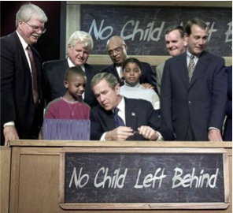
No Child Left Behind- 2002
Signed into law by George W. Bush in January 2002
Concern that the American education system was no longer internationally competitive
NCLB increased funding from the Federal government to specifically increase performance of certain groups of students.
○ Ex. English-language learners, special education, minority children

Slide 15
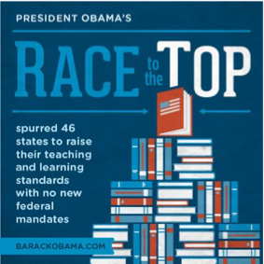
Race to the Top- 2009
Signed into law by Barack Obama in 2009
States compete for education grants from the federal government
$4 billion to 11 states & D.C.
4 year goals to improve test scores, graduation rates, and college attendance
Goal: revitalize and inspire states to improve their education

Slide 16
Testing in Schools
Standardized testing debate
A typical student takes 112 mandated standardized tests between pre-K and 12th grade
Does not count tests and quizzes given by teachers in class

Slide 17
Languages in Schools
The U.S. has no official language policy
○ States like New Mexico and Hawaii have two official languages (English + Spanish and Olelo Hawai’i)
○ 28 States have English only policies
Most students can learn a second language in middle or high school
Lau v. Nichols (1974) – cannot discriminate against individuals who do not speak English in education
○ Development of ELL programs in schools

Slide 18
Public, Private, & Charter Skills
Public Schools – schools funded by state (public) tax dollars
○ Tuition free
○ State Curriculum
Charter Schools – independently run public schools with established “charters” or missions
○ Schools of choice
○ Tuition free
Private Schools – schools funded by private corporations
○ Double selection: students and parents select their school and the school selects their students
○ Different functions – sometimes religious
○ Charge Tuition

Slide 19
College vs. University
College – an institution of higher education offering B.S. and B.A. (Bachelors of Science and of Arts) degrees
University – an institution of higher education offering degrees at the Bachelors, Masters, and Doctoral levels

Slide 20
Public and Private Intuitions
Public Universities – systems run and funded by the state
○ 4-year
○ In-state tuition lower
○ Ex. University of Wisconsin
26 campuses statewide
About 180,000 students total
Mission of teaching, research, and
public service
Community Colleges
○ 2 year instead of 4 year
○ Offer continuing and adult education
○ Local – funded by local

Slide 21
Public and Private Institutions
Private Universities
○ 4-year
○ Run and funded by private corporations
○ Elite
■ Ivy League – Harvard, Columbia, Princeton, Yale, Cornell, Dartmouth, and Brown ○ High tuition (up to $70,000/year)

Slide 22
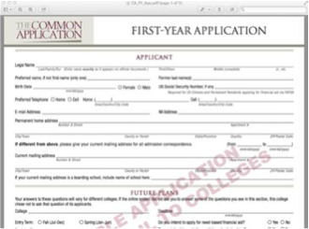
Application Process
Both Public and Private institutions (except Community Colleges) have competitive application processes
○ Some acceptance rates are as low as 4%
SAT (Scholastic Aptitude Test) or ACT (American College Testing) (standardized tests)
GPA - Grade Point Average
Essays and Personal Statement

Slide 23
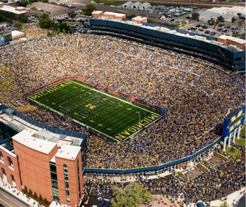
Campus Culture
College and University Campuses offer much more than academic classes
There are student groups, clubs, sports, activities etc.
Students usually live on or near campus for their four years
School spirit and pride

Slide 24
Compare and Contrast Scattegories
I will say a statement about the American Education System
Then with your team you have 1 min to come up with a similarity or difference in the Moroccan system
After 1 min you must hold up your answer – if it works you get one point
Be creative! If you have the same answer as another group, you don’t get the point!
Ex. – “In some states in the U.S., students must take a second language.” Ex: “In Morocco, students must study French in public schools.”

Slide 25
A List of Iconic Movies that talk about the American Education System
Documentaries:
Waiting for Superman (2010)
The Lottery (2010)
Ivory Tower (2014)
Dramas:
Stand & Deliver (1988)
Dead Poets Society (1989)
Freedom Writers (2007)

