Slide 1
Time and stress Management
Professor kabli
October 10, 2018

Slide 2
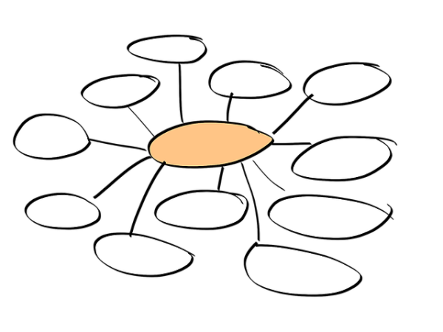
In-class activity #1
Create a Mind Map using the topic “Stress Management.” In groups, brainstorm words, ideas, or strategies that come to mind.

Slide 3
The daily to-do list
The best way to handle a long and sometimes complex array of study tasks is to simply write them down and then decide where you will start.
Here are some ways:
Buy an exercise book or some other diary type notebook and use a new page for each day and write four column headings at the top of the page: Task, Priority, Time, Done
THE TASK COLUMN
List every job which is currently needing attention. This will include homework assignments which are due tomorrow as well as longer term projects due in four to six weeks.
You can also include personal chores, domestic duties or any other tasks which need to be done that day. When noting these tasks, BE SPECIFIC!!!

Slide 4
The daily to-do list cont…
THE PRIORITY COLUMN
After listing all the tasks, read through them and assign a 1, 2 or 3, depending upon how important and urgent they are. The number one jobs, those that are both important and urgent, need attention today and should be done first. The number two jobs are less urgent and may be carried over until tomorrow, if time is tight. The number three jobs are least urgent and least important and you may even find that they don't get done at all after being carried forward over several days.

Slide 5
The daily to-do list cont…
THE TIME COLUMN
An estimate of how much time you think the various tasks might take. By estimating the respective times for various tasks, you can prevent the frustrating experience of planning a day's work and then finding that you really need a week to accomplish all of the tasks.

Slide 6
The daily to-do list cont…
THE DONE COLUMN
The done column is reserved for ticks which you record after completing the individual tasks. Be certain to include this column and to use it, as it represents a reward after working through your task.
After several days of efficient and productive work, you will feel a great sense of accomplishment after seeing all of those ticks in the Done columns.

Slide 7
The semester plan
Once you start organizing your days, you will realize how important it is to look ahead several weeks to plan for the larger projects. The best approach to take is to construct a semester plan.
Here are the steps for constructing a semester plan:
Cut a Manila folder in half along the seam and holding it horizontally, rule one page in the following manner (or use can just use a regular piece of paper or do it on a computer)
Draw columns and rows to construct a grid, so that your assignments and exams can be inserted into a box opposite the subject and under the correct week of the semester.
Draw a column for your subjects down the left border.
Across the top, draw a sufficient number of columns for the total number of weeks in the semester, plus several for the examination period as well.
Draw in the row lines across the page so that each subject you are presently studying is represented down the left- hand border of the chart.

Slide 8
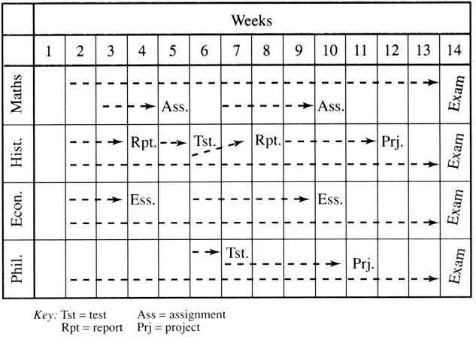

Slide 9
The semester plan cont…
At one glance, you can see exactly where your very heavy periods are going to be.
The dotted lines have been inserted from a preceding week and lead up to a report, essay, project or an exam. The dotted lines represent lead-up time, or the period over which you want to be actively working on each task.
As assignments are given to you, note the task in the relevant box and draw a lead-up arrow to indicate the preparation time → The first day of preparation time for any assignment is the day it is assigned.
If you are given three or four major essays or projects at the beginning of the semester, decide how many weeks you plan to spend preparing each one and insert the dotted arrow on your semester plan.

Slide 10
Things to consider
Carry your semester plan on you in a notebook or post it on the wall directly in front of your study place. Whenever you look up from your books, the overall agenda for the semester will be clearly apparent
When writing your daily To Do list, consider the tasks which are due for submission over the next four to six weeks and include the relevant weekly sub-goals in your list.
Start revising for exams early. Exams count for a very large percentage of your final marks in most subjects.

Slide 11
Long-term career goals
Take advantage of work experience programs which give you some first-hand experience in a workplace (internship, apprenticeship, volunteering).
Arrange to see several people who are working in a job area which you find interesting.
Be prepared to change your career goals as you acquire more experience. Many individuals change careers several times and do not really get settled into a long-term career until they are well into their twenties or even their thirties.

Slide 12
In-class activity #2
On a piece of paper write your FIRST NAME, LAST NAME, EMAIL, and SEMESTER/GROUP.
I will collect your writing.
1. What is a “SMART goal”? Define each letter.
➤ The following is not a SMART goal: “I want a new job”
2. How can you improve it so that it meets the requirements of a SMART goal?

Slide 13
SMART GOALS
What does SMART stand for?
To make sure your goals are clear and reachable, each one should be:
Specific (simple, sensible, significant).
Measurable (meaningful, motivating).
Achievable (agreed, attainable).
Relevant (reasonable, realistic and resourced, results-based).
Time bound (time-based, time limited, time/cost limited, timely, time-sensitive).

Slide 14
Is my goal a smart goal?
Questions to ask yourself:
➤ S- Which? What? Who? Where? When? Why?
➤ M- How much or how many?
➤ A- Does it describe a result?
➤ R- Is this goal realistic or relevant to you or your skill/experience? (yes/no)
➤ T- By when?

Slide 15
Diet, exercise, and sleep
BOTTOM LINE!!!!
Eat well-balanced meals at regular intervals.
Engage in some sort of physical activity for at least 30 minutes to an hour per day.
Sleep at least 7-8 hours a night.

Slide 16
Helpful apps
Wunderlist is a collaborative to-do list app that helps you coordinate with your friends, family, and teammates.
Clear is a simple, well-designed to-do list app that makes it easy to stay on top of everything you need to accomplish.
RescueTime is a time-tracking app that records how and where you spend your time online.
Timely is an innovative time-tracking app that not only keeps tabs on how long projects take, but also helps you organize your workweek more efficiently.

