Slide 1
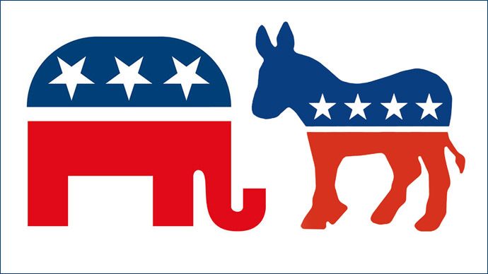
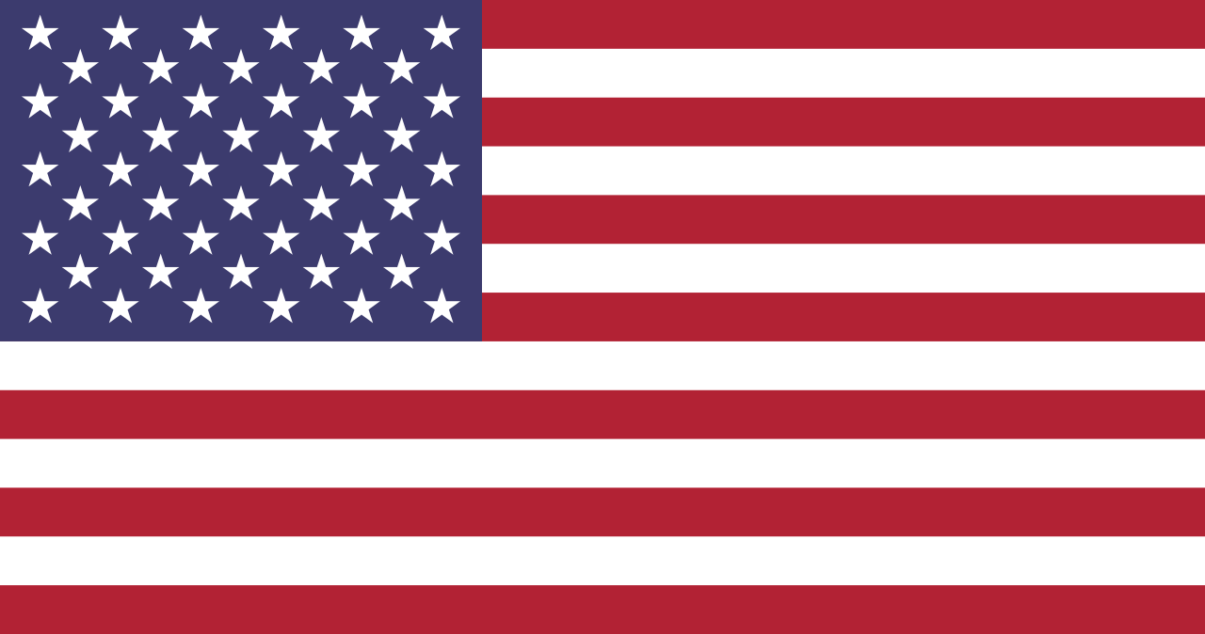
U.S. Political Parties and the System of Government
Professor Oumama Kabli
November 5, 2018

Slide 2
What are political parties?
Political parties are groups of people that are organized based on their political beliefs and goals. In some cases, political parties are large powerful organizations that run much of the government. Two Main Parties In the United States there are two main political parties: Democrats and Republicans. These two parties run much of the government. Because these two parties are so powerful, the United States government is often called a "two-party system."

Slide 3
Elections in a Two-Party System
The elections in a two-party system are often held in two phases. The first phase is the primary election. In the primary election each party elects a candidate to represent their party. The next phase is called the general election. In the general election, the public votes between the winners of the primary election. These elections are sort of like playoffs in sports. The primary elections are like the semifinals and the general elections are like the finals.

Slide 4
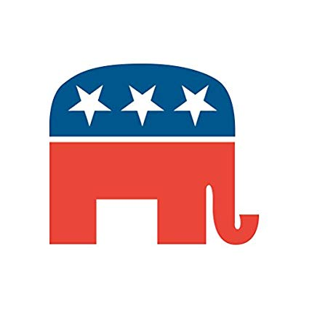
Republicans
The Republican Party was founded in 1854 by anti-slavery activists. It is generally associated with smaller government and lower taxes. Members of the Republican Party are often referred to as "conservatives." The symbol of the Republican Party is the elephant.

Slide 5
Republicans cont…
In general, Republicans tend to take a more conservative stand on issues. They believe that the federal government should not play a big role in people's lives.
Most Republicans favor lower taxes and less government spending on social programs. They believe in less government intervention in business and the economy.

Slide 6
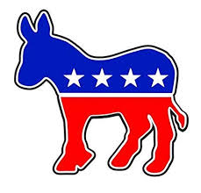
Democrats
The Democratic Party was founded in 1828. It is generally associated with larger government programs and higher taxes. Members of the Democratic Party are often referred to as "liberals" or "progressives." The symbol of the Democratic Party is the donkey.

Slide 7
Democrats cont…
Democrats are sometimes referred to as "the Party of the People," attracting immigrants, blue-collar workers, women, and minorities.
Democrats tend to take a more liberal stand on important issues. They believe that the federal government should take a more active role in people's lives, particularly those who are in need.
For example: Franklin D. Roosevelt's presidency (1933–1945). To pull the U.S. out of an economic depression, Roosevelt started government programs to create jobs.

Slide 8
Why an Elephant?
In a cartoon that appeared in Harper's Weekly in 1874, the cartoonist Thomas Nast drew a donkey clothed in lion's skin, scaring away all the animals at the zoo. They saw the elephant as a symbol of strength.

Slide 9
Why a Donkey?
It was first associated with Democrat Andrew Jackson's 1828 presidential campaign.
His opponents called him a jackass (a donkey), and Jackson decided to use the image of the strong-willed animal on his campaign posters.
Later a cartoonist named Thomas Nast used the Democratic donkey in newspaper cartoons and made the symbol famous.

Slide 10
2016 Electoral Vote

Slide 13
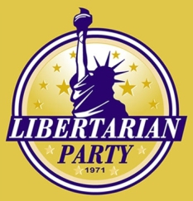
Other Parties
There are other political parties in the United States, but they have not been able to make a significant impact in the government. Some of these parties include the Libertarian Party, the Green Party, and the Constitution Party.
Political parties that have had power in the past include the Whigs, the Federalists, and the Democratic-Republicans.

Slide 14
Advantages and Disadvantages
There are good and bad things about a two party system:
Positives: having only two parties helps the government to run smoother. Two-party systems can lead to a more stable government and less radical politics.
Negatives: two-party systems give the voters only two choices. Voters start to think that their vote doesn't count for much, causing them not to participate. It also makes it difficult for people with new ideas to have an influence in the government.

Slide 15
Left-Wing or Right-Wing?
Sometimes political parties are described as being "left-wing" or "right-wing."
The Democrats are considered "left" and the Republicans "right."
The terms "left" and "right" originally came from the National Assembly during the French Revolution when the supporters of the king stood on the right and the supporters of the revolution on the left.

Slide 17
The Legislative Branch
The legislative branch drafts proposed laws, confirms or rejects presidential nominations for heads of federal agencies, federal judges, and the Supreme Court, and has the authority to declare war.
This branch includes Congress (the Senate and House of Representatives) and special agencies and offices that provide support services to Congress. American citizens have the right to vote for Senators and Representatives through free, confidential ballots.

Slide 18
The Legislative Branch cont…
Senate: There are two elected Senators per state, totaling 100 Senators. A Senate term is six years and there is no limit to the number of terms an individual can serve.
House of Representatives: There are 435 elected Representatives, which are divided among the 50 states in proportion to their total population. There are additional non-voting delegates who represent the District of Columbia and the territories. A Representative serves a two-year term, and there is no limit to the number of terms an individual can serve.

Slide 19
The Executive Branch
The executive branch carries out and enforces laws. It includes the president, vice president, the Cabinet, executive departments, independent agencies, and other boards, commissions, and committees.
American citizens have the right to vote for the president and vice president through free, confidential ballots.

Slide 20
The Executive Branch cont…
Key roles of the executive branch include:
President: The president leads the country. He or she is the head of state, leader of the federal government, and Commander in Chief of the United States Armed Forces. The president serves a four-year term and can be elected no more than two times.
Vice president: The vice president supports the president. If the president is unable to serve, the vice president becomes president. The vice president can be elected and serve an unlimited number of four-year terms as vice president, even under a different president.
The Cabinet: Cabinet members serve as advisors to the president. They include the vice president, heads of executive departments, and other high-ranking government officials. Cabinet members are nominated by the president and must be approved by a simple majority of the Senate—51 votes if all 100 Senators vote.

Slide 21
The Electoral College Explained!
A U.S. president is elected via the Electoral College system.
It is not a building or institution, rather the
"College" is really just a way to name a group of 538 people who are the formal electors who cast an electoral vote.
And so a president needs to win a majority — 270 electors who then cast their vote for the president.
Why 538 electors?
That number is decided as the total number of voting representatives in Congress — 435 members of the House of Reps plus 100 senators and three electors have been given to the District of Columbia.

Slide 29
The Judicial Branch
The judicial branch interprets the meaning of laws, applies laws to individual cases, and decides if laws violate the Constitution. It's comprised of the Supreme Court and other federal courts.

Slide 30
The Judicial Branch cont…
Supreme Court: The Supreme Court is the highest court in the United States. The Justices of the Supreme Court are nominated by the president and must be approved by the Senate.
Nine members make up the Supreme Court: a Chief Justice and eight Associate Justices.
There is no fixed term for Justices. They serve until their death, retirement, or removal in exceptional circumstances.

Slide 33
Sources
https://www.ducksters.com/history/us_government/two-party_system.php
http://www.scholastic.com/browse/article.jsp?id=4706
https://www.usa.gov/branches-of-government
https://www.bbc.co.uk/newsround/37848449
https://www.abc.net.au/news/2016-09-27/us-electoral-college-explainer/7787472
https://www.rte.ie/news/special-reports/2016/1018/824930-uselectionelectoralcollege/

