Slide 1
Using Non-Verbal Communication in Oral Communication
Professor Oumama Kabli
March 13, 2019

Slide 2
Presentations/Debates!
If you haven’t already, please see me about your presentation/debate topic OR selecting your presentation date! FIRST PRESENTATIONS START NEXT WEEK!
I have uploaded the presentation rubric onto the course website under “Week 4.” Please reference it before your presentation date to ensure you receive the best mark possible!
The presentation schedule has also been uploaded on the course website. Please see me for any errors that needed to updated.
Presenters must bring their Apogee cards with them the day of the presentation. DO NOT FORGET!!!

Slide 3
CHANGES: Presentation Format
To avoid an unnatural flow of presenting, I will allow students to speak collectively for 5-6 minutes. (Times may vary for the groups doing debates)
Rather than have one student speak at a time, I will allow students to speak collectively within 5-6 minutes.
With that being said… this does not mean that some students will not speak at all or speak only a little. I will still keep track of how much time each person is speaking, as well as your delivery, content, and body language.

Slide 4
Revisiting the Debate Structure
PRO #1- Opening Argument
CON #1- Opening Argument
PRO #2- The Rebuttal
CON #2- The Rebuttal
CROSSFIRE- Questioning
PRO #3- Final Arguments
CON #3- Final Arguments

Slide 5
What is Non-Verbal Communication?
Non-verbal communication includes facial expressions, the tone and pitch of the voice, gestures displayed through body language and the physical distance between the communicators.
These non-verbal signals can give clues and additional information and meaning over spoken (verbal) communication.
70 to 80% of communication is non-verbal!

Slide 6
How does Non-Verbal Communication help people?
Reinforce or modify what is said in words.
For example, people may nod their heads when saying “Yes” to emphasize that they agree with the other person.
A shrug of the shoulders and a sad expression when saying “I’m fine, thanks” may actually imply that things are not really fine at all!

Slide 7
How does Non-Verbal Communication help people? Cont…
Convey information about their emotional state.
Your facial expression, your tone of voice, and your body language can often tell people exactly how you feel, even if you have hardly said a word.
“Are you OK? You look a bit down.”
We know how people feel from their non-verbal communication.

Slide 8
How does Non-Verbal Communication help people? Cont…
Define or reinforce the relationship between people.
If you have ever watched a couple sitting talking, you may have noticed that they tend to ‘mirror’ each other’s body language.
They hold their hands in similar positions, they smile at the same time, and they turn to face each other more fully. These movements reinforce their relationship.

Slide 9
How does Non-Verbal Communication help people? Cont…
Provide feedback to the other person.
Smiles and nods tell someone that you are listening and that you agree with what they are saying. Movement and hand gestures may indicate that you wish to speak. These subtle signals give information gently but clearly.

Slide 10
How does Non-Verbal Communication help people? Cont…
Regulate the flow of communication
There are a number of signals that we use to tell people that we have finished speaking, or that we wish to speak.
A firm closing of the lips indicates that we have nothing more to say.
Making eye contact with someone during a meeting and nodding slightly will indicate that you wish to speak.

Slide 11
Forms of Non-Verbal Communication
Body movements (hand gestures or nodding or shaking the head)
Posture, or how you stand or sit, whether your arms are crossed, and so on
Eye contact, where the amount of eye contact often determines the level of trust and trustworthiness
Para-language, or aspects of the voice apart from speech, such as pitch, tone, and speed of speaking

Slide 12
Forms of Non-Verbal Communication cont…
Closeness or personal space (determines the level of intimacy, and which varies very much by culture)
Facial expressions (including smiling, frowning and blinking; facial expressions that show strong emotions, such as fear, anger, and happiness)
Physiological changes (you may sweat or blink more when you are nervous, and your heart rate is also likely to increase)

Slide 13
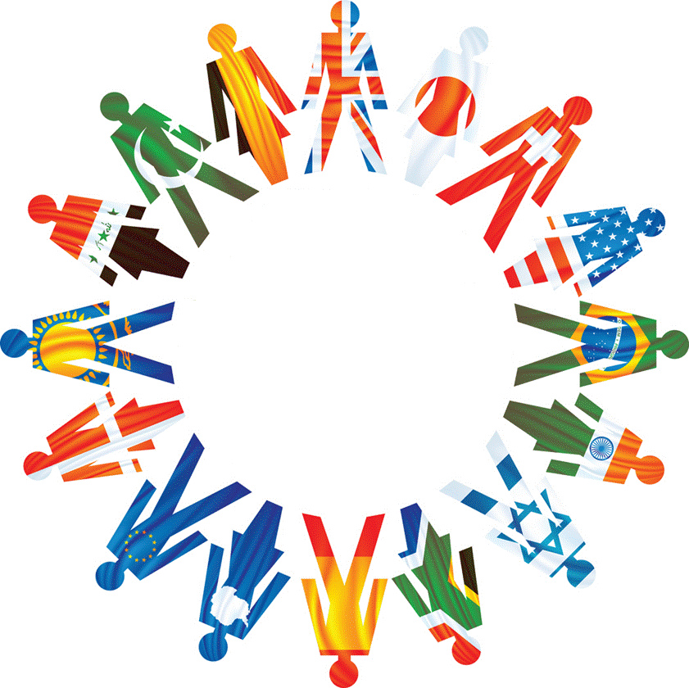
The Cultural Context
Most of us learn to interpret non-verbal communication as we grow up and develop.
It is a normal part of how we communicate with other people, and most of us both use it and interpret it differently.

Slide 14
Activity #1- Charades
I will give students a scenario or an emotion and they must act it out in the front of the class.
You cannot use words or sounds to give away what you are doing.
The rest of the class must guess what you are doing!

Slide 15
The Cultural Context: Examples
Western cultures mostly consider eye contact to be a good gesture → Asian, Middle Eastern, Hispanic and Native American do not take it as a good expression. It is taken as a rude and offensive expression.
In Eastern cultures women should especially not have eye contact with men as it shows power or sexual interest. In some cultures, whereas, gazes are taken as a way of expression. Staring is taken as rude in most cultures.

Slide 16
The Cultural Context: Examples
Gestures such as thumbs up can be interpreted differently in different cultures.
It is taken as “Okay” sign in many cultures whereas is taken as a vulgarism in others like Latin American cultures and in Japan some even take it as money.

Slide 17
The Cultural Context: Examples
Snapping fingers to get the attention of a waiter as alright whereas some take it as disrespect and very offensive.
Showing feet is taken as offensive in some Middle Eastern cultures.
Some cultures take pointing fingers as insulting too. In Polynesia, people stick out their tongue to greet people which is taken as a sign of mockery in most of other cultures.

Slide 18
What are some cultural non-verbal forms of communication you are aware of? In Morocco? Arab Culture? USA? (Let’s keep it appropriate please!)

Slide 19
Activity #2- Pictionary
I will give you a word or a sentence and you will have to draw what it is. You cannot use words or sounds.
The goal of the game is to guess what the “picturist” is trying to communicate through the pictures that they draw.
Please raise your hands when giving an answer!

Slide 20
Sources
https://www.skillsyouneed.com/ips/nonverbal-communication.html
https://www.businesstopia.net/communication/non-verbal-communication-different-cultures

