Slide 1
Voice Projection and Confidence Building
Professor Oumama Kabli
March 6, 2019

Slide 2
Group Presentations/Debates
PRIORITIES:
Today we must finalize group members and topics!
We will be choosing presentations dates, have one member from each group write their name down on a piece of paper, I will draw each name randomly to determine which day each group will be presenting.

Slide 3
How to Project Your Normal Speaking Voice
Avoid shallow breaths:
How you breathe has a direct effect on the way your voice is projected. Taking shallow breaths uses only the air in your lungs, which causes you to run out of air quicker.
Keep good breathing posture:
In order to breathe for projection, you need to be standing straight, without slouching in order to let the most air in as you breathe. The only thing that should be moving is your stomach as you inhale and exhale.

Slide 4
How to Project Your Normal Speaking Voice cont…
Breathe from your belly:
As you inhale, place your hand on your belly, feel it expand. You want to make sure your chest doesn't move as you inhale, this means you're not breathing with your diaphragm.

Slide 6
How to Project Your Normal Speaking Voice cont…
Work on enunciating:
In order for a word to be properly pronounced and enunciated, it must be accurately formed, completed, and supported by your breathing.
For Example: Pay attention to how you pronounce words ending in ‘ing’ like driving, drinking, or working. Say them out loud. Did you pronounce them as ‘driv-in’, ‘drink-in’, and ‘work-in’?

Slide 7
How to Project Your Normal Speaking Voice cont…
Put energy into your words:
Don’t sound like a monotone robot! You will put people to sleep!
Exercise your tongue and lips. Over exaggerate your words by stretching your cheeks. Make your lips more nimble with lip and tongue exercises that require opening your vowels and making your consonants clearer and better enunciated.

Slide 8
What is the difference between articulation and pronunciation?
Articulation → making sounds through the movement of speech organs (change the speech sounds by moving the teeth, lips and tongue)
Pronunciation → refers to the manner in which we make speech sounds. We use stress, intonation and rhythm in order to change the sound of the word.

Slide 9
Activity: Pen Drills
How to do it:
Hold a pen vertically in your mouth, between your teeth, while you read
Why you should do it?
The pen creates an obstacle, forcing your tongue to work harder and you to over-articulate. This is good for developing the kind of exaggerated face/mouth/tongue movements that produce greater speech clarity.
Tips:
This drill will only actually help you if you commit to it.
The key is to really work those facial muscles and focus on articulation.
You’ll know you’re doing it right when you start to feel like your face looks really stupid.

Slide 10
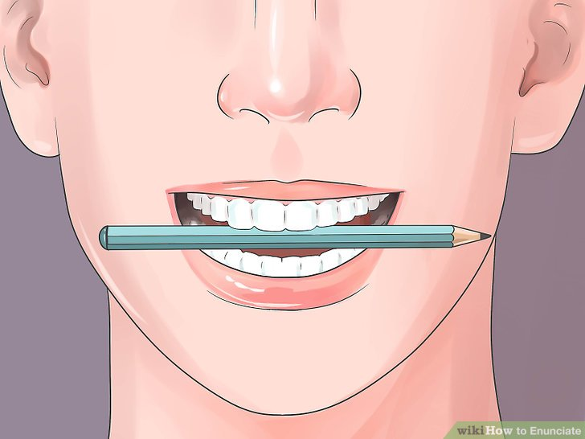

Slide 11
Pen Drill Passage
“When the sunlight strikes raindrops in the air, they act as a prism and form a rainbow. The rainbow is a division of white light into many beautiful colors. These take the shape of a long round arch, with its path high above, and its two ends apparently beyond the horizon.”
From Fairbanks, G. (1960). Voice and articulation drillbook, 2nd edn. New York: Harper & Row. pp124-139.

Slide 12
Tips for Building Confidence
Practice! Make sure that you are ready for your presentation by practicing your presentation both individually and as a group!
Visuals. These can be very helpful when you feel like you do not have anything to fall back on or get stuck during the presentation.
Ask the audience questions! This takes the spotlight off of you as the speaker.

Slide 13
Tips for Building Confidence cont…
Interpret anxiety as excitement, especially at the beginning of your presentation.
Realize that the audience won’t always know when you have made a mistake, so just keep going.
Choose what you will say wisely. Vocabulary matters.

Slide 14
Tips for Building Confidence cont…
Make the audience laugh.
If you are going to memorize anything, memorize the beginning of what you will say. This will give you the momentum for your speech.

Slide 15
Activity: Speaking Nonsense
I will give you a topic to discuss
Talk about the topic for 2 minutes straight.
You cannot say "Um", etc. or use the word "and" more than twice. You must also keep eye contact with the audience at all times.

Slide 16
Sources
https://www.wikihow.com/Project-Your-Normal-Speaking-Voice
https://www.vbriefly.com/2014/11/26/drillin-like-a-villain-how-to-get-better-at-debate-by-danny-debois/
https://www.differencebetween.com/difference-between-articulation-and-vs-pronunciation/
http://debate-central.ncpathinktank.org/the-best-speaking-drills-and-when-to-do-them/

