Slide 1
Work Organization (Distribution of Departments and Responsibilities Inside a Company)
Professor Oumama Kabli
March 19, 2019

Slide 2
Question(s) of the Day
Answer question 1 OR question 2
If you could hold the whole world’s attention for 30 seconds, what would you say?
If you had to work but didn’t need the money, what would you choose to do?

Slide 3
What is a Corporate Structure?
Corporate structure refers to the organization of different departments or business units within a company.
Depending on a company’s goals and the industry which it operates in, corporate structure can differ significantly between companies.
Each of the departments usually performs a specialized function while constantly collaborating with each other to achieve the corporate goals and values.

Slide 4
Organizational Structure Examples
1- Line and functional structure
2- Project-based structure
3- Matrix structures

Slide 5
Line and Functional Structure
A) Line Structure
President or CEO (Chief Executive Officer) is at the top.
Then there are the directors or VPs (Vice-Presidents) of specific areas, followed by managers, and so on, until the operational personnel.

Slide 6
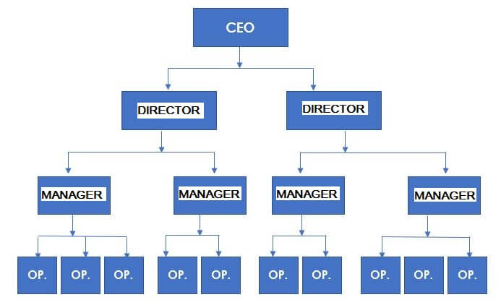

Slide 7
Line and Functional Structure cont…
B) Functional Stucture
Comes from the line structure; the difference is that employees in an area need to report to all the directors.
For example → an employee from the finance department may be called upon by the HR (Human Resource) manager to handle a matter related to this area. The IT (Information Technology) manager may do the same, and so forth.

Slide 8
Line and Functional Structure cont…
Is the most used structure in many companies and organizations
Most suitable for small companies, such as manufacturing, hotels, medical clinics, or other types of business
Informal structure which allows functional control over employees without generating conflicts between managers.

Slide 9
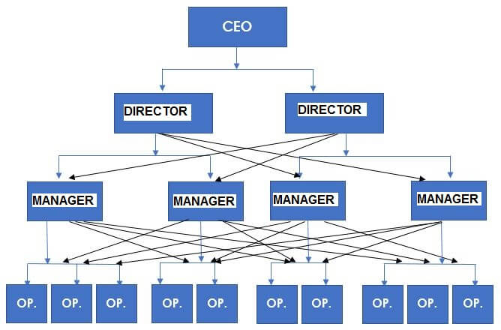

Slide 10
Project-based Structure
Highly dynamic and creative companies – such as software developers, architecture firms, event organization companies – typically use this structure → characterized by a series of specialized employees
In each project, collaborators report to a different leader. Once they complete the project, a manager assigns them a new project and leader.

Slide 11
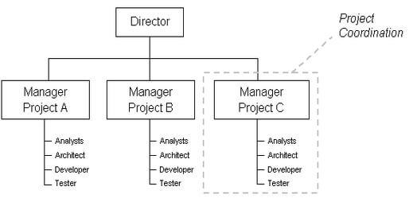

Slide 12
Matrix Structures
Used both by companies that are constantly launching new products and marketing campaigns, by companies that have project-based structures
Believe that supervision is necessary and important.

Slide 13
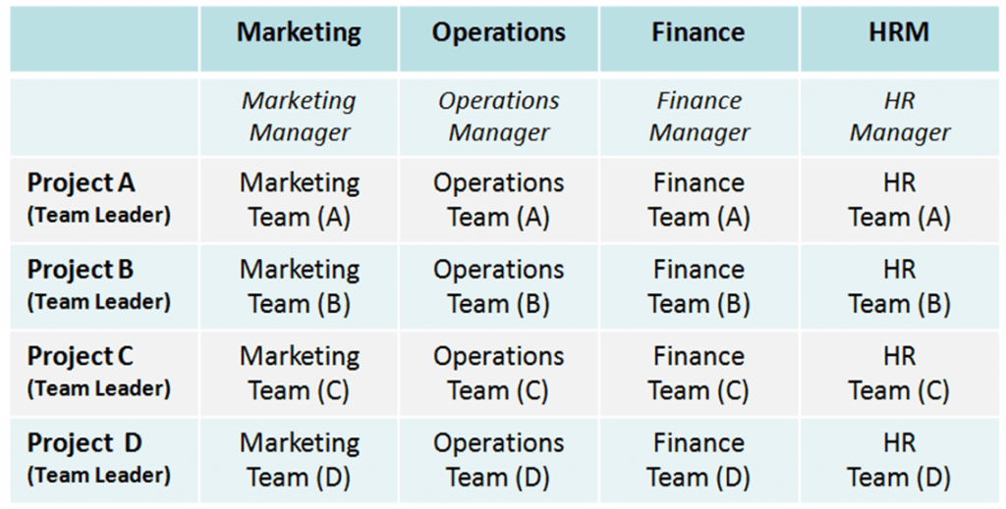

Slide 14
Common Departments in a Company Structure
Marketing (Sales and Marketing)
Human Resources (Personnel)
Finance (Accounts)
Operations (Production)

Slide 15
Marketing (Sales and Marketing)
Promotes your business and drives sales of its products or services.
It provides the necessary research to identify your target customers and other audiences.

Slide 16
Human Resources (Personnel)
Responsible for recruiting, screening, interviewing and placing workers. They may also handle employee relations, payroll, benefits, and training.
Plan, direct and coordinate the administrative functions of an organization.

Slide 17
Finance (Accounts)
The part of an organization that manages its $$$.
Planning, organizing, auditing, accounting for and controlling its company's finances.
Usually produces the company's financial statements.

Slide 18
Operations (Production)
Create the highest level of efficiency possible within an organization.
It is concerned with converting materials and labor into goods and services as efficiently as possible to maximize the profit of an organization.

Slide 19
Activity #1
In small groups, think of a company name and logo.
Think of a product you want to create/invent
Create an organization chart of all the team members within your organization, identifying the type of structure, as well as job titles.

Slide 20
Sources
https://corporatefinanceinstitute.com/resources/knowledge/finance/corporate-structure/
https://www.heflo.com/blog/business-management/small-business-organizational-structure-examples/
http://resource.download.wjec.co.uk.s3.amazonaws.com/vtc/2015-16/WJEC-15-16_06/pdf/eng/business-functions/chapter1.pdf
https://smallbusiness.chron.com/description-marketing-department-56409.html
https://www.allbusinessschools.com/human-resources/job-description/
https://bizfluent.com/list-6765198-duties-production-department-.html

