Slide 1
Writing a Cover Letter
Professor Oumama Kabli
February 26, 2019

Slide 2
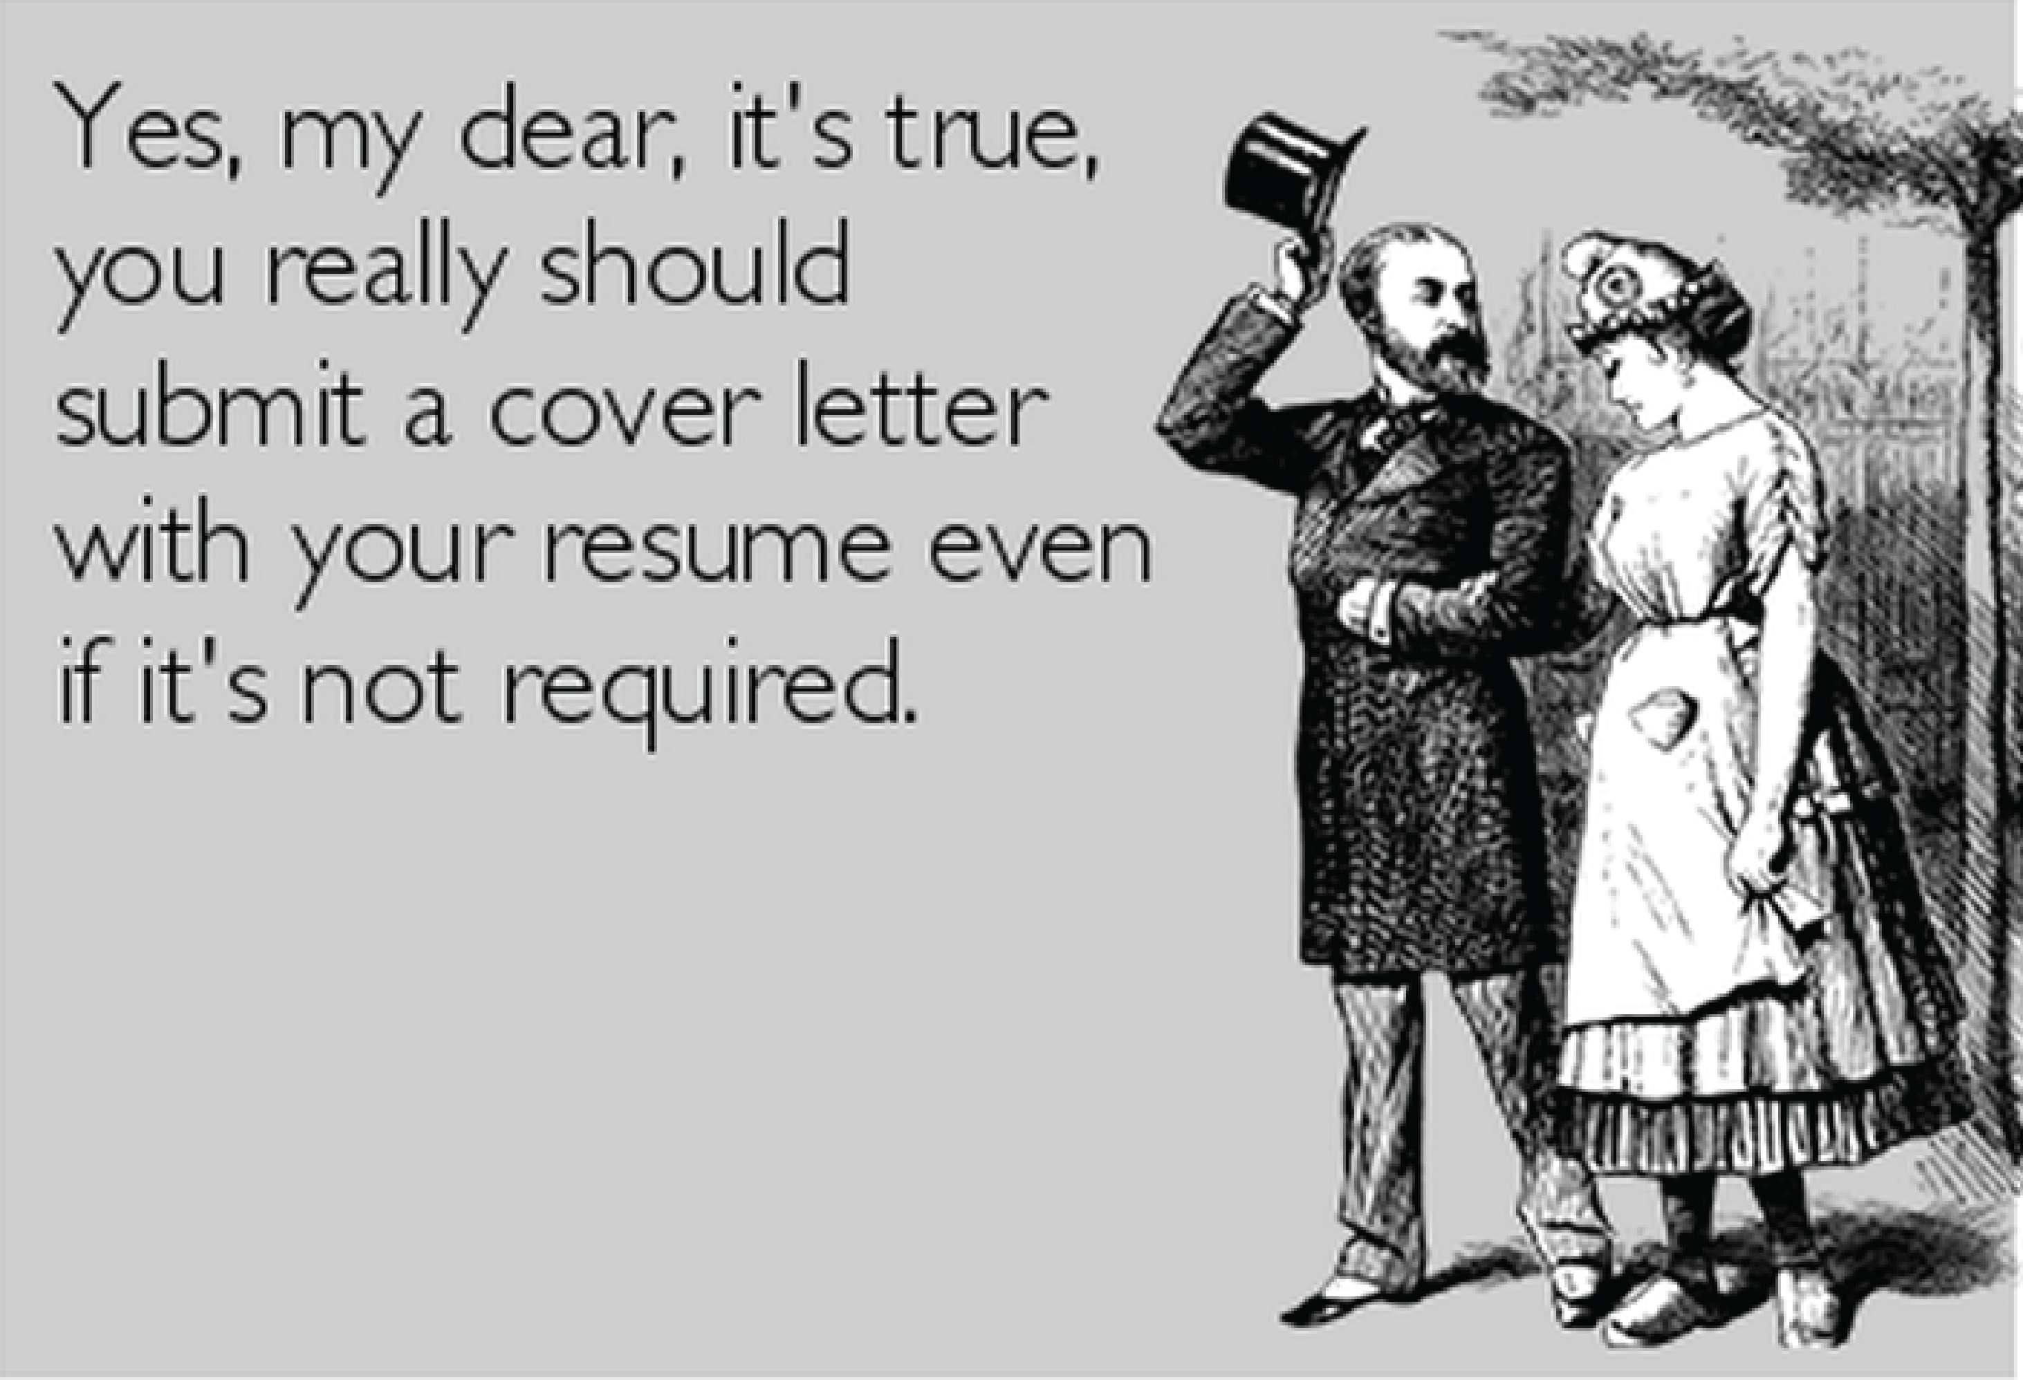

Slide 3
What is the Purpose of a Cover Letter?
The ultimate goal of the cover letter is to distinguish you from other candidates and persuade the reader(s) that they should take the next step with you, and set up an interview.
It's also an opportunity to demonstrate how the position and organization align with your experience and professional interests.

Slide 4
What is the Purpose of a Cover Letter? cont…
1. What are the applicant's most relevant experiences, competencies, skills, and accomplishments as they relate to the position?
2. Does the applicant understand the industry and the organization's needs—and can she/he add value as a strong contributor?
3. Why is the applicant interested in the position, and is this person someone who would fit within our organization's culture and work environment?

Slide 5
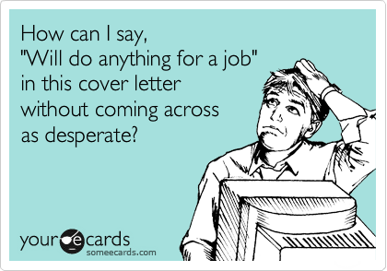

Slide 6
How to Get Started
Step 1: Research the Position, Company/Organization and Industry
Review and highlight key qualifications and responsibilities of the position.
Research the company/organization to fully understand their defining characteristics
Determine the industry's key purpose and understand the company/organization's positioning within it.
Identify keywords and trends for the company/organization as well as the position/sector in which you are applying.

Slide 7
How to Get Started cont…
Step 2: Plan the letter
Outline your previous professional experiences that most directly relate to the position description and company culture.
Review your resume for strong transferable experiences that will help you be successful in the position.
Selectively discuss only 2 to 3 key experiences that best represent skills, knowledge, and outcomes that are relevant to the position.
Focus on the employer's interests and needs, NOT your agenda → Avoid overusing "I" statements such as "I am responding…", "I am interested…", "I have developed…", etc
Personalize and customize each letter to every individual position.

Slide 8
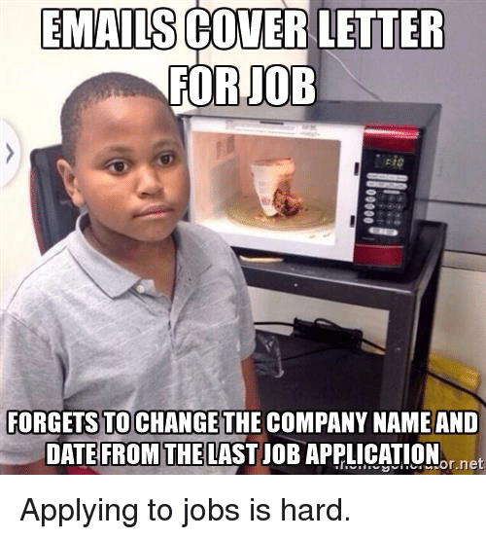

Slide 9
How to Get Started cont…
Step 3: Basic Cover Letter Structure and Etiquette
Contact Information: formal business letters include the name, address, and contact information for both the writer and the addressee.
Your Contact Information: Use the same header from your resume.
Company Contact Information: In block format, include the name & title of contact person, (company name, and street address complete with city & state.
Date: include the date that you are submitting the documents.

Slide 10
How to Get Started cont…
Salutation
Always address the letter to an individual/committee
Dear (Mr./Ms.) Last Name (do not use Mrs. or Miss)
Alternate Title examples: Dear Human Resources Director, Dear Hiring Manager, Dear Selection Committee, Dear Search Committee
Avoid general and vague salutations such as: Dear Sir or Madam, To Whom It May Concern

Slide 11
How to Get Started cont…
Introductory Paragraph
Clearly describes your interest in the company/industry, the position you are applying to, and states what you bring to the position.
Engage your reader immediately with a sentence that grabs their attention: "Can your fast-growing market research division use an interviewer with 1 ½ years of field survey experience, a B.A. in English with strong communication skills, and a real desire to succeed? If so, please consider me for the position of xxxxxx.”
Reference an individual with whom you have communicated from the organization: "After discussing the fascinating mission of XXX company, with (name of individual), I was further driven through my desire to make a difference, to apply for the position of xxxxx".

Slide 12
How to Get Started cont…
Middle Paragraph(s)
Clearly describes how your selected experiences will be beneficial to your employment in the said position.
In one or two paragraphs, you will highlight key strengths and abilities from previous experiences and/or education.
Summarize your relevant qualifications and emphasize your accomplishments.
DO NOT rehash your resume, but include additional information not available in the bullet points to help the reader understand the relationship between your experience and the position applying to.

Slide 13
How to Get Started cont…
Concluding Paragraph
This paragraph will restate your interest and enthusiasm in the position.
It should ask for a specific action ("I look forward to speaking with you further as to how my xxxx skills/experience will be beneficial to xxxx organization in the xxxx position") and facilitate a reply (by giving your contact information). Always reference your resume.

Slide 14
How to Get Started cont…
Formatting
Single-spaced paragraphs
If submitting electronically, save as a PDF
Use the same header as your resume
Left-align format
Font ( 10 – 12 pt font) in the same style as your resume
No longer than one page

Slide 15
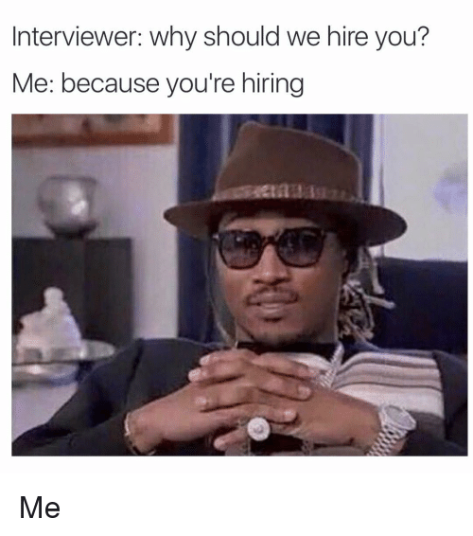

Slide 16
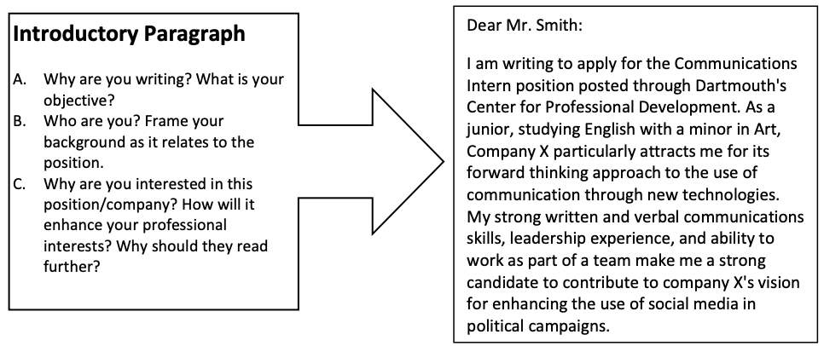

Slide 17
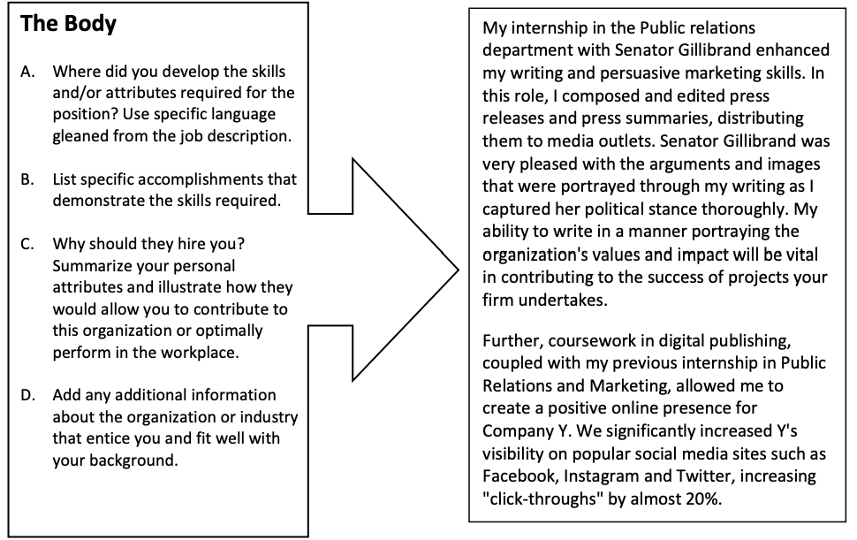

Slide 18
