Slide 1
Writing a Resume / Proper Email Practices
Professor Oumama Kabli
February 19, 2019

Slide 2
What is the difference between a RESUME and a CURRICULUM VITAE?
RESUME:
provides a summary of your education, work history, credentials, and other accomplishments and skills. Resumes are the most common document requested of applicants in job applications.
A resume should be as concise as possible. Typically, a resume is one page long, although sometimes it can be as long as two pages.
CURRICULUM VITAE (CV):
include extensive information on your academic background, including teaching experience, degrees, research, awards, publications, presentations, and other achievements.
CVs are lengthier than resumes, and include more information, particularly details related to one’s academic and research background.

Slide 3
✅ Resume Basics ✅
** For the sake of this class, we will focus on building a proper resume rather than a CV**

Slide 4
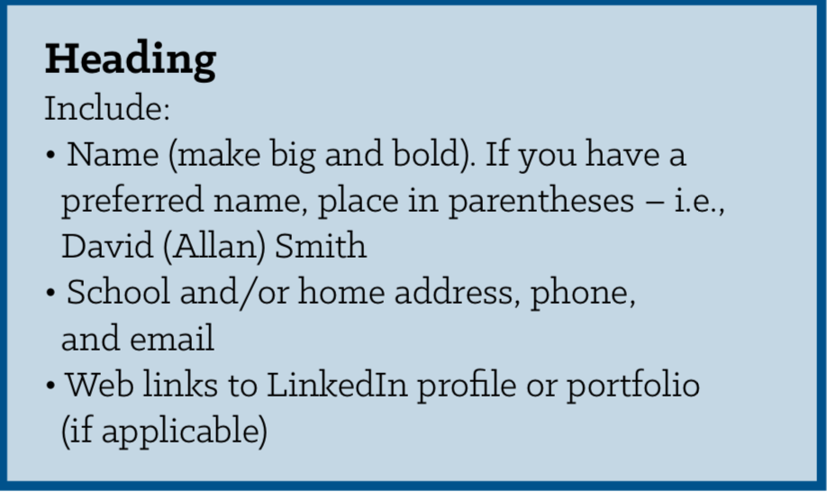

Slide 5
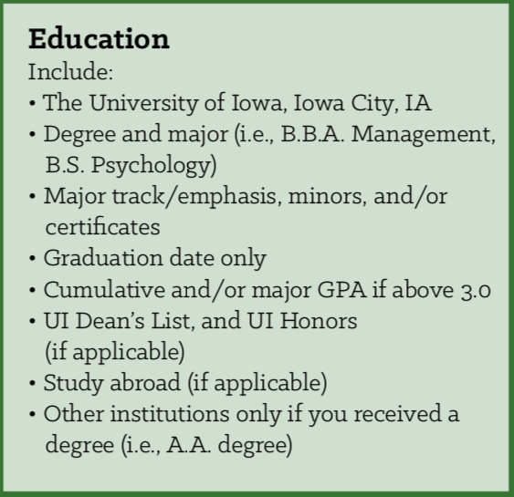

Slide 9
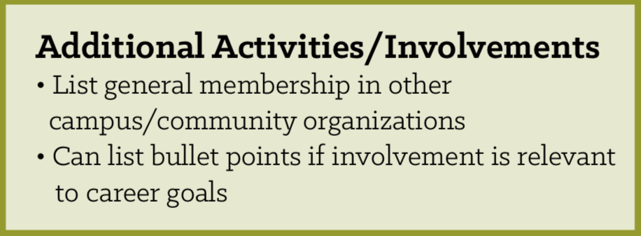

Slide 10
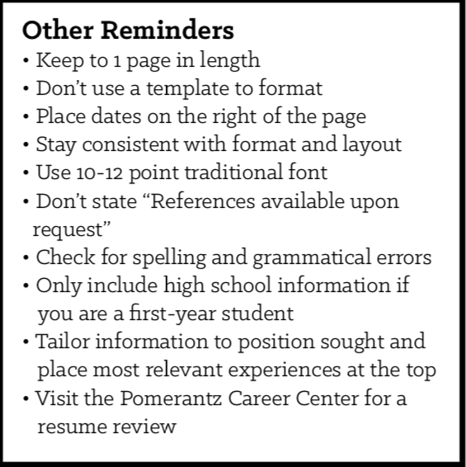

Slide 11
Types of Resumes
Chronological (most common):
Most familiar and commonly used template for employers.
Presents information in reverse chronological order (most recent experiences first).
Focuses on experiences sections through descriptive bullet points outlining your accomplishments and contributions
Targeted:
Target your experiences and skills sets to the purpose of your resume – a job/internship application; networking/Informational interviews; job shadows, etc.
Review the organization's website and position description to gauge key skills and keywords they use to integrate in your resume.
Follow the chronological resume format.

Slide 12
✅ Action Verbs ✅

Slide 13
Why are they important?
Action verbs start each sentence off with a bang!
The alternative is writing your achievements out in complete sentences, with ‘I worked on’ and ‘I did’. This is extremely repetitive and boring for the hiring manager to read.
Writing long sentences full of dull descriptions of the work you’ve done does nothing to capture attention or interest.
Strong action words, however, are a far more persuasive language tool that allows you to be concise and impactful.

Slide 14
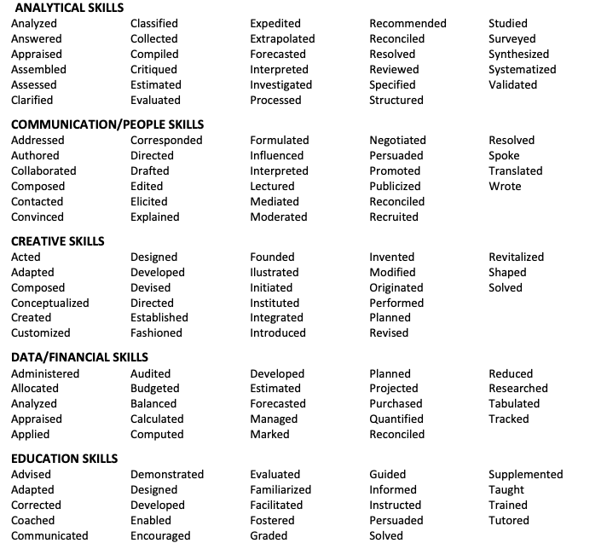

Slide 15
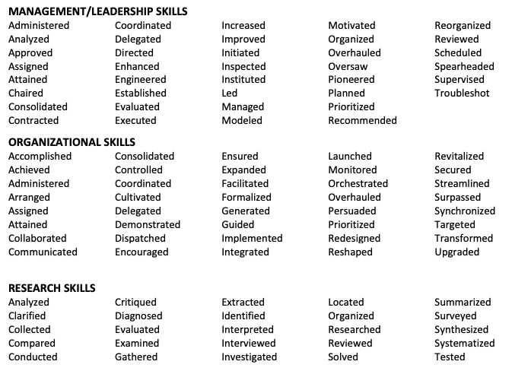

Slide 16
Class Activity
Using the action verbs we discussed, write 2 bullet points that could be included on a resume.

Slide 17
Quantifying Resume Bullets
What does quantifying mean?
Putting something in numbers!
Why is it important?
It helps employers really picture the impact you’ve made in your position and it more impressive.
Remember:
Numbers = Results = Value
***It’s your job to prove your value to employer by flaunting your accomplishments***

Slide 18
Examples of Quantifying
Candidate #1: Fundraised for breast cancer research
Candidate #2: Increased fundraising contributions for breast cancer research by 25% since 2014, raising a total of $15,000 in 2015
*Even though they both do the same thing, Candidate #2 looks much more impressive because he’s quantifying his results and showcasing his value.
Instead of saying:
Wrote articles for local newspaper
You you say something like…
Wrote 8 articles per week for Big Town Sentinel, which covers 5 towns and has 8,000+ daily readers

Slide 19
Helpful Reminders!
🤓
Include relevant jobs: Think about the skills and experiences required of the job you want. Include any jobs where you developed these qualities. Even if your work experiences aren’t directly related, think of ways to highlight experiences you had that are relevant to the job you want.
**For example, you might include a former job as a cashier if it helped you develop customer service or leadership skills.
Include extracurricular activities: Because you likely have limited work experience, emphasize any non-work activities. These might include clubs, sports, babysitting, volunteer work, clubs (English Club) or community service. All of these activities can show your skills and abilities.
Include leadership experience: Have you held a position in a club, or been a captain on a sports team? Have you had any leadership responsibilities at your previous jobs? Be sure to list these experiences, as they show your ability to lead a team.
Edit, edit, edit: Proofread resume carefully before submitting it. A clean, error-free resume will make you look professional. (Submit your resume as a PDF when applying for a job, not a Word document)

Slide 20
✅ Proper Email Practices ✅

Slide 21
Writing Successful Emails: Best Practices
● Send emails from a professional account that includes your name in the address
○ No: xoxoGOTaddictxoxo@gmail.com
○ Yes: YounesElHaj151@gmail.com
● Choose a subject line that succinctly describes the point of your message
○ No: Hi teacher, I need help with my homework plz
○ Yes: Dear, Professor Kabli. I was hoping you would be able to answer some questions about the homework.
● Begin your message with an appropriate greeting
○ No: Dearest and kindest teacher
○ Yes: Dear Ms. Kabli/Professor Kabli
● Write your message in the body of the email as briefly as it can be, using complete sentences, formal language, and proper punctuation

Slide 22
Writing Successful Emails: Best Practices cont…
● If you are responding to a message, thank the sender for his/her message when appropriate.
● Avoid emojis and abbreviations
● Conclude your email with a proper closing at the end

Slide 23
Email #1
Hey Potential Boss,
i wanna apply for the job u posted on ur website. send me more information.
-Youssef

Slide 24
Email #2
Dearest and most lovely teacher,
I found your class really funny lol but you made a mistake with my grade. I did all the work and was present for every class. Why, teacher?
Bye, Youssra

Slide 25
Good Email

Slide 26
Formulas for Greetings
Dear Mr./Mrs. (Last Name)
Dear Colleagues,
Dear,
Hello (Name)
Hi (Name) -- Less formal
****To Whom it May Concern

Slide 27
Formulas for Opening Sentences
I hope you are doing well.
Thank you for your message/call/email.
I hope this finds you well.
It was great talking to you ________
It’s great to hear from you.
Thanks for the additional information/quick response

Slide 28
Formulas for Last Sentences
I really appreciate the help/time/support you’ve given me.
Thank you once again for your help in this matter.
I look forward to seeing you again.
If you require any further assistance, please don’t hesitate to contact me.
Let me know if you need anything else.

Slide 29
Formulas for Closings
Thanks (again)
Sincerely (Yours)
Best (Wishes)
Kind Regards

Slide 30
Class Activity
Draft an email to Mary, a potential client of your company. She sent you an email requesting more information about the coffee makers that you sell.
Dear Ahmed, I hope you’re doing well. I was wondering whether you could provide more information about the coffee makers that your company is selling, as my company is potentially interested in buying some.
Thank you for your time,
Mary

Slide 31
Sources
https://www.thebalancecareers.com/cv-vs-resume-2058495
https://theundercoverrecruiter.com/action-verbs-resume/
https://www.wor
https://kitdaily.com/quantify-anything-resume/
https://www.thebalancecareers.com/college-student-resume-example-2063202

