Slide 1
Writing Essays
Professor Oumama Kabli
November 7, 2018

Slide 2
Question of the Day
What is one issue in your country you would change and why? What changes would you propose? (Provide three main ideas)

Slide 3
Clarify the Topic
If you are in doubt about any aspect of the essay topic, then clarify the matter straightaway (students can misread or wrongly interpret assigned essay topics)

Slide 4
Write a Preliminary Outline
The outline might be as general as:
Introduction
Body
Summary/Conclusion
At the preliminary stage, just put some initial ideas down. They can be changed as you become more informed about the essay topic.

Slide 6
Formatting an Outline for your Essay

Slide 7
The Thesis Statement
Every paper you write should have a main point, a main idea, or central message. The argument(s) you make in your paper should reflect this main idea. The sentence that captures your position on this main idea is.
How long does it need to be?
A thesis statement focuses your ideas into one or two sentences. It should present the topic of your paper and also make a comment about your position in relation to the topic. Your thesis statement should tell your reader what the paper is about and also help guide your writing and keep your argument focused.

Slide 8
Hooks and Attention Grabbers

Slide 9
Ways to Grab the Attention of your Reader

Slide 12
Introductory Paragraph

Slide 13
The Thesis Statement cont..
In order to write a successful thesis statement:
Avoid putting your thesis statement in the middle of a paragraph or late in the paper. Your thesis should be evident in the introductory or first paragraph of your essay.
Be as clear and as specific as possible; avoid vague words.
Indicate the point of your paper but avoid sentence structures like, “The point of my paper is…”
***A thesis statement is an assertion, not a statement of fact or an observation. ***

Slide 14
Formatting an Outline for your Essay cont…

Slide 16
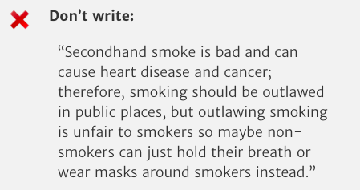
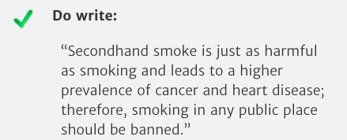
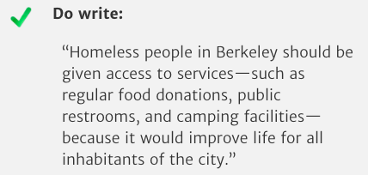
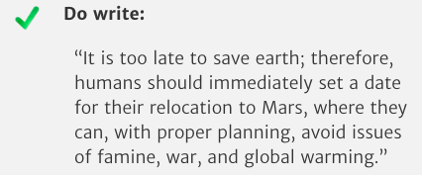
Examples of Good and Bad Thesis Statements

Slide 17
Formatting an Outline for your Essay cont…

Slide 20
Initial Reading/Research
It is very likely you will have to write essays on topics about which you know absolutely nothing, so you will need to do some background reading.
Your library will probably have a range of books and reference sources which can give you a brief overview before you get down to more specific reading.
Some reference sources which might be helpful include encyclopedias, newspapers, journals, and the INTERNET of course! (Google Scholar)

Slide 21
Note-Taking
Note-taking is a critical step in researching — it is your record of information from various sources.
Write a note about where in the essay you think the note or each point belongs.
You can use the letters and numbers (1,2,3, a,b,c), to identify main ideas and sub-points.
The actual note or summary you make from the reference source should be preferably in your own words.

Slide 22
Writing the First Draft
The best way to get into the writing is to sort through your notes and organize them under relevant headings.
Specify in writing a goal for writing your essay.
Write the goal down → Remember, people who work to written goals are much more likely to accomplish them.

Slide 23
Proofreading

Slide 24
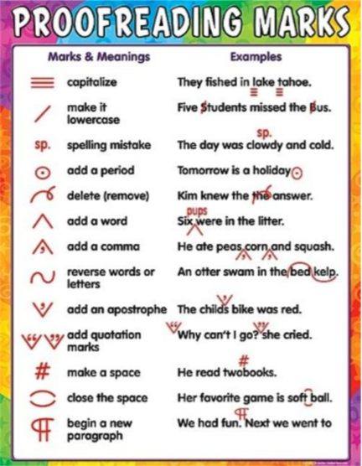
Learning from your Marked Essays
Read through the entire essay and take careful note of any corrections and comments.

